Slide 1
DevOps & Beyond
Staying out of silos and into containers

Slide 2
Debugging Container Overview

Slide 3
Debugging Container Overview
Notes:
NEED SOME SORT OF INTRO HERE

Slide 4
Debugging Container Overview
Let’s take a look at some of the most common container debugging technics:
View stdout history with the logs command
Stream stdout with the attach command
Execute arbitrary commands with exec
Override the ENTRYPOINT
Add options with the CMD
Pause and unpause a container
Get process stats with the top command
View container details with the inspect command
View image layers with the history command
Run one process in each container
There are a few other advanced techniques that didn’t fit into my arbitrary limit of ten tips, but perhaps they’ll be a subject for another time!
Notes:
1 — View stdout history with the logs command.
SHARE:
Lots of programs log stuff to stdout, especially when things go south. Anything that gets written to stdout for the process that is pid 1 inside the container will get captured to a history file on the host, where it can be viewed with the logs command.
$ docker run -d --name=logtest alpine /bin/sh -c “while true; do sleep 2; df -h; done” 35f6353d2e47ab1f6c34073475014f4ab5e0b131043dca4454f67be9d8ef1253 $ docker logs logtest Filesystem Size Used Available Use% Mounted on none 93.7G 2.0G 87.0G 2% / tmpfs 3.8G 0 3.8G 0% /dev tmpfs 3.8G 0 3.8G 0% /sys/fs/cgroup ... etc ...This history is available even after the container exits, as long as its file system is still present on disk (until it is removed with docker rm). The data is stored in a json file buried under /var/lib/docker. You can get the complete path using the inspect command, which we’ll look at later. The log command takes options that allow you to follow this file, basically tail -f, as well as choose how many lines the command returns (tail -n). By default the command returns all lines.
2 — Stream stdout with the attach command.
SHARE:
If you want to see what is written to stdout in real time then the attachcommand is your friend.
$ docker run -d --name=logtest alpine /bin/sh -c “while true; do sleep 2; df -h; done” 26a329f1e7074f0c0f89caf266ad145ab427b1bcb35f82557e78bafe053faf44 $ docker attach logtest Filesystem Size Used Available Use% Mounted on none 93.7G 2.0G 87.0G 2% / tmpfs 3.8G 0 3.8G 0% /dev tmpfs 3.8G 0 3.8G 0% /sys/fs/cgroup … etc … Filesystem Size Used Available Use% Mounted on none 93.7G 2.0G 87.0G 2% / tmpfs 3.8G 0 3.8G 0% /dev tmpfs 3.8G 0 3.8G 0% /sys/fs/cgroup … etc …By default this command attaches stdin and proxies signals to the remote process. Options are available to control both of these behaviors. To detach from the process use the default `ctrl-p ctrl-q` sequence. Note that running a command in a loop the way I am above can make detaching a little wonky, but it works fine for normal stuff.
3 — Execute arbitrary commands with exec.
SHARE:
Maybe the most powerful all-around tool in your kit, the exec command allows you to run arbitrary commands inside a running container.
$ docker run -d --name=exectest alpine watch “echo ‘This is a test.’ >> /var/log/test.log” 70ddfdf5169e755177a812959808973c92974dba2531c42a21ad9e50c8a4804c $ docker exec exectest cat /var/log/test.log This is a test. This is a test. This is a test. This is a test.You can even use exec to get an interactive shell in the container.
$ docker run -d --name=exectest alpine watch “echo ‘This is a test.’ >> /var/log/test.log” 91e46bf5d19d4239a2f30af06669d4263580a01187d2290c33d7dee110f76356 $ docker exec -it exectest /bin/sh / # ls -al /var/log total 12 drwxr-xr-x 2 root root 4096 Mar 23 05:37 . drwxr-xr-x 10 root root 4096 Mar 23 05:37 .. -rw-r — r — 1 root root 192 Mar 23 05:38 test.log / # exit $Note that exec only works while the container is running. So for a container that is crashing you’ll need to fall back on the logs command.
4 — Override the ENTRYPOINT.
SHARE:
Every docker image has an entrypoint and command, whether defined in the dockerfile at build time or as an option to the docker run command at run time. The relationship between entrypoint and command can be a little confusing, and there are different ways to use them, but here is one setup that follows best practices and gives you a lot of customization ability.
Let’s say you are running a django app. First, you define the python process that runs the app as the entry point. This will make sure it is pid 1 inside the container. You can do this in the dockerfile.
ENTRYPOINT [“python”, “manage.py”, “runserver”]You can also do it on the command line when docker run is called, and that is where the cool comes in. If the entry point is specified on the command line then it overrides any entry point set in the dockerfile when the image was built. This can be a powerful tool. Imagine a situation where the django image in this example was crashing due to a configuration problem. Instead of running manage.py you want to get a shell and poke around.
docker run -d -p 80:80 --entrypoint /bin/sh /myrepo/mydjangoappNow you can jump in, check the config, even try to run the manage.py command interactively to see what happens.
5 — Add options with the CMD.
SHARE:
Back to that confusing relationship between ENTRYPOINT and CMD. Here’s one way to look at it: the ENTRYPOINT defines the process that runs as PID 1 in the container, and the CMD adds options to it. If you don’t specify an ENTRYPOINT but you do specify a CMD then the implicit entrypoint is /bin/sh -c. CMD, like ENTRYPOINT, can be specified on the command line when docker run is called, which makes it another powerful tool for modifying container behavior. However, the usage is a little different.
docker run -d -p 80:8000 /myrepo/mydjangoapp 0.0.0.0:8000Anything that appears after the image name in the docker run command is passed to the container and treated as CMD arguments, basically as if it were specified in the dockerfile like this:
ENTRYPOINT [“python”, “manage.py”, “runserver”] CMD ["0.0.0.0:8000"]Additional arguments can be passed as space-delimited parameters to the docker run call. This is a very convenient and flexible way to reconfigure an image for debugging purposes, by passing an option to increase log verbosity, for example.
6 — Pause and unpause a container.
SHARE:
I doubt you’ll have use for this one very often, but it’s cool so I’m throwing it in here anyway. Using the docker pause command you can pause all of the processes inside a container.
$ docker run -d --name=pausetest alpine /bin/sh -c “while true; do sleep 2; date; done” e81e1bc519e4eb2e30a1c1e57198f0060147fa749ff8f93ba4f69bdf8a114311The container is just echoing the date to stdout, so we can watch it with the attach command.
$ docker attach pausetest Wed Mar 23 06:21:40 UTC 2016 Wed Mar 23 06:21:42 UTC 2016Now pause the container, wait a bit, then unpause it.
$ docker pause pausetest pausetest $ docker unpause pausetest pausetestAnd back in our other window where attach is running…
mark@viking:~/workspace/cluster-iperf$ docker attach pausetest Wed Mar 23 06:21:40 UTC 2016 Wed Mar 23 06:21:42 UTC 2016 Wed Mar 23 06:22:06 UTC 2016 Wed Mar 23 06:22:08 UTC 2016Actually I don’t have to stretch my imagination too much to come up with scenarios where this would be useful. It might be nice to freeze the current state of a server while I eat lunch or something.
7 — Get process stats with the top command.
SHARE:
The docker top command is exactly what it sounds like: top that runs in the container.
$ docker run -d — name=toptest alpine:3.1 watch “echo ‘Testing top’” fc54369116fe993ae45620415fb5a6376a3069cdab7c206ac5ce3b57006d4241 $ docker top toptest UID PID … TIME CMD root 26339 … 00:00:00 watch “echo ‘Testing top’” root 26370 … 00:00:00 sleep 2Some columns removed to make it fit here. There is also a docker stats command that is basically top for all the containers running on a host.
8 — View container details with the inspect command.
SHARE:
The inspect command returns information about a container or an image. Here’s an example of running it on the toptest container from the last example above.
$ docker inspect toptest [ { “Id”: “fdb3008e70892e14d183f8 ... 020cc34fec9703c821”, “Created”: “2016–03–23T17:45:01.876121835Z”, “Path”: “/bin/sh”, “Args”: [ “-c”, “while true; do sleep 2; echo ‘Testing top’; done” ], … and lots, lots more. } ]I’ve skipped the bulk of the output because there’s a lot of it. Some of the more valuable bits of intelligence you can get are:
Current state of the container. (In the “State” property.)
Path to the log history file. (In the “LogPath” field.)
Values of set environment vars. (In the “Config.Env” field.)
Mapped ports. (In the “NetworkSettings.Ports” field.)
Probably the most valuable use of inspect for me in the past has been getting the values of environment vars. Even with largely automated deployments I’ve run into issues in the past where the wrong arg was passed to a command and a container ended up running with vars set to
incorrect values. When one of your cloud containers starts choking commands like inspect can be a quick cure.
9 — View image layers with the history command.
SHARE:
This one is more of a build time diagnostic tool, but the questions it answers sometimes come up in debugging situations as well. The docker historycommand shows the individual layers that make up an image, along with the commands that created them, their size on disk, and hashes.
$ docker history alpineThe returned table is quite wide so I won’t try to illustrate it here. If you run into a situation where the contents of your image aren’t what you expect, this command may solve your puzzle for you.
10 — Run one process in each container.
SHARE:
This last one is less of a debugging tip, and more of a best practice that will definitely make debugging, and reasoning about the state of your container a lot easier. Docker containers are meant to run a single process that is PID 1 inside the sandbox. You can make that process a shell and spin up a bunch of stuff in the background, or you can make it supervisord and do the same, but it’s not really what containers are good at and it hobbles systems meant to manage and monitor them.
The main benefit of running one process per container is that it’s easier to reason about the state of the container at run time. The container comes up when the process comes up and dies when it dies, and platforms like Docker Compose, kubernetes, and Amazon ECS can see that and restart it. They can also monitor the health (liveness and readiness) of a single-process container, but it is much more difficult to define declaratively what either of those things means when they depend on multiple processes being in good health inside the container.
Conclusion
There are a few other advanced techniques that didn’t fit into my arbitrary limit of ten tips, but perhaps they’ll be a subject for another time.
SHARE:
They include things like advanced logging scenarios, exporting and importing container file systems, and commands to diff image layers. In the meantime the tips in this article will hopefully get the top off that black box and make your transition to running containers a little easier.

Slide 5
Using Eclipse IDE for Debugging

Slide 6

Using Eclipse IDE for Debugging
For the following, we’ll download a ready made project:
In Eclipse, import the app directory of that project as an existing maven project:
Let’s take a look at how that will look...
$ git clone https://github.com/docker/labs
$ cd labs/developer-tools/java-debugging
File> Import Select Maven> Existing Maven Projects> Next
Next,
Slide!
Notes:
SHARE:
THIS EXERCISE YOU’LL USE IN THE FOLLOWING SLIDES COMES FROM AN EXERCISE SHARED AT DOCKERCON 2017
In-container Java Development: Eclipse
Pre-requisites:
Docker for OSX or Docker for Windows
Eclipse (install Eclipse IDE for Java EE Developers)
Java Development Kit
Maven for Eclipse (see instructions for adding the Maven plug-in to Eclipse)
Getting Started
On the command line clone the registration-docker repository
git clone https://github.com/docker/labs
cd labs/developer-tools/java-debugging
In Eclipse, import the app directory of that project as an existing maven project
File> Import Select Maven> Existing Maven Projects> Next
(images/eclipse_import_existing_maven_project_1.png)
SOURCE:
https://github.com/docker/labs/blob/master/developer-tools/java-debugging/Eclipse-README.md

Slide 7
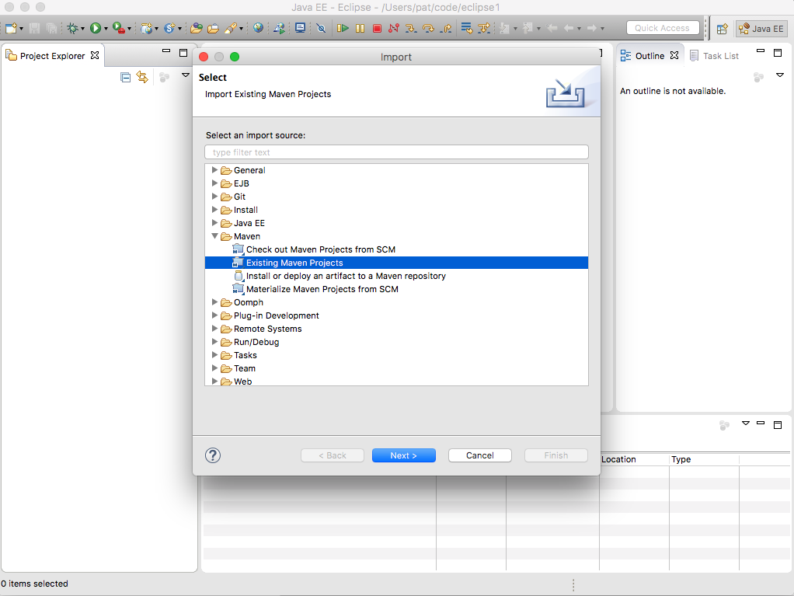
In-container Java Development: Eclipse
File> Import Select Maven> Existing Maven Projects> Next
Notes:
In-container Java Development: Eclipse
In Eclipse, import the app directory of that project as an existing maven project
File> Import Select Maven> Existing Maven Projects> Next
(images/eclipse_import_existing_maven_project_1.png)
SOURCE:
https://github.com/docker/labs/blob/master/developer-tools/java-debugging/Eclipse-README.md

Slide 8
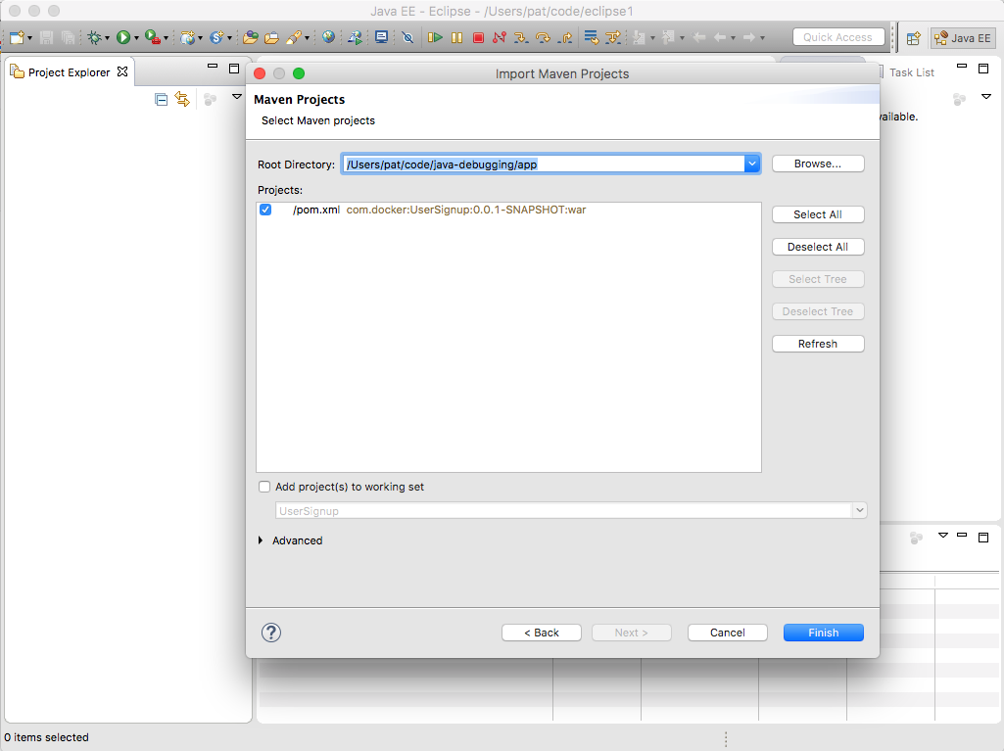
In-container Java Development: Eclipse
Select the app subdirectory of the directory where you cloned the project
Notes:
In-container Java Development: Eclipse
Select the app subdirectory of the directory where you cloned the project.
(images/eclipse_import_existing_maven_project_2.png)
SOURCE:
https://github.com/docker/labs/blob/master/developer-tools/java-debugging/Eclipse-README.md

Slide 9
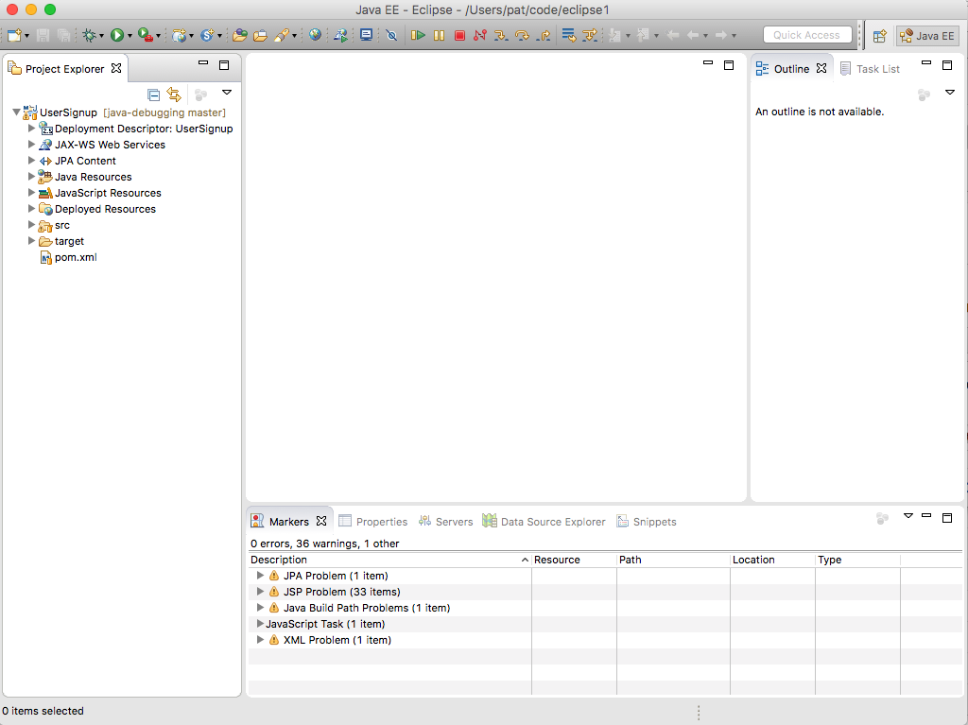
In-container Java Development: Eclipse
Select the pom.xml from the app directory, click `Finish`
Notes:
In-container Java Development: Eclipse
Select the pom.xml from the app directory, click `Finish`.
(images/eclipse_import_existing_maven_project_3.png)
SOURCE:
https://github.com/docker/labs/blob/master/developer-tools/java-debugging/Eclipse-README.md

Slide 10
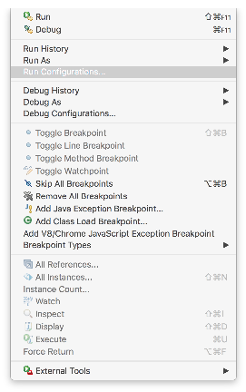
Building the Application
The application is a basic Spring MVC application that receives user input from a form, writes the data to a database, and queries the database
The application is built using Maven
To build the application click on:
Let’s take a look...
`Run` > `Run configurations`
Notes:
Building the application
The application is a basic Spring MVC application that receives user input from a form, writes the data to a database, and queries the database.
The application is built using Maven.
To build the application click on `Run` > `Run configurations`
![](images/eclipse_maven_run_config3.png)
SOURCE:
https://github.com/docker/labs/blob/master/developer-tools/java-debugging/Eclipse-README.md

Slide 11
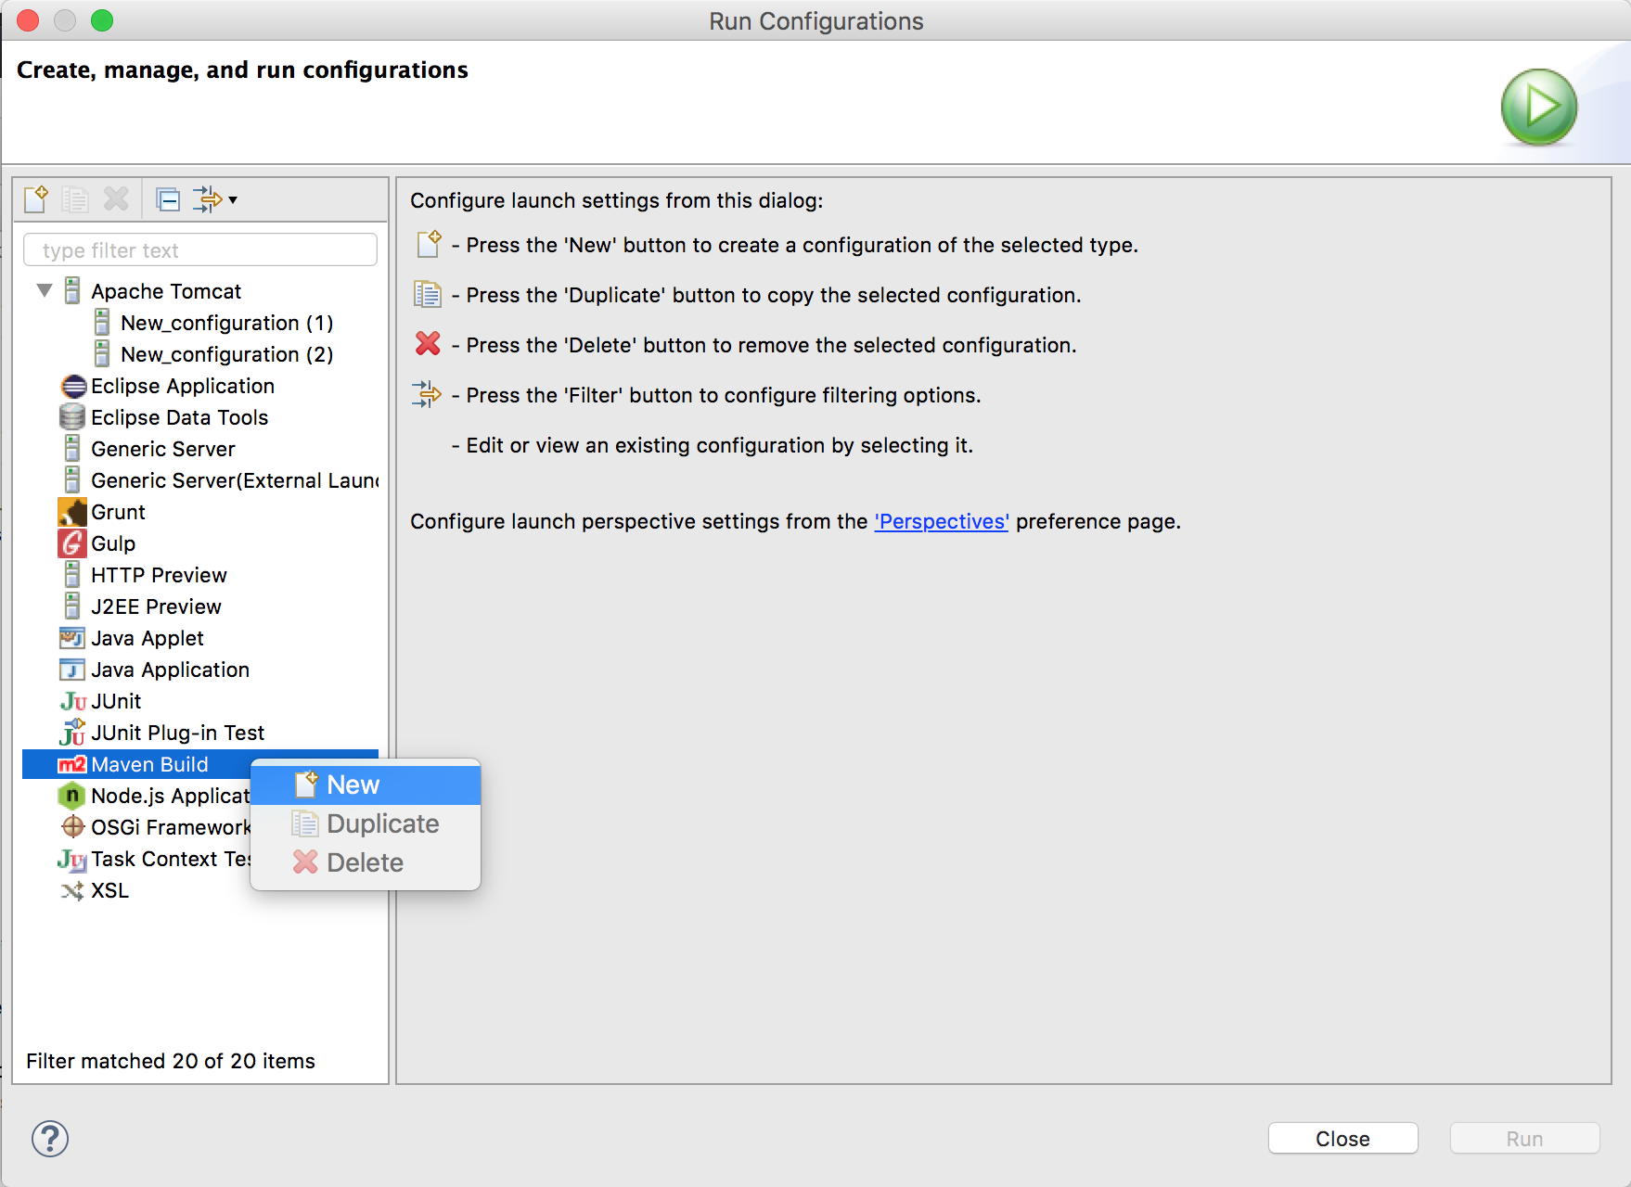
Building the Application
Select `Maven build` > `New`
Notes:
Building the application
Select `Maven build` > `New`
![](images/eclipse_maven_build_new.png)
SOURCE:
https://github.com/docker/labs/blob/master/developer-tools/java-debugging/Eclipse-README.md

Slide 12
Building the Application
Enter a `Name` for the configuration
Set the base direct of the app `<path>/registration-docker/app`
Set the `Goals` to `clean install`.
Click `Apply`Click `Run`
Let’s take a look...
Next,
Slide!
Notes:
Building the application
Enter a `Name` for the configuration.
Set the base direct of the application `<path>/registration-docker/app`.
Set the `Goals` to `clean install`.
Click `Apply`Click `Run`
![](images/eclipse_maven_run_config_apply.png)
SOURCE:
https://github.com/docker/labs/blob/master/developer-tools/java-debugging/Eclipse-README.md

Slide 13
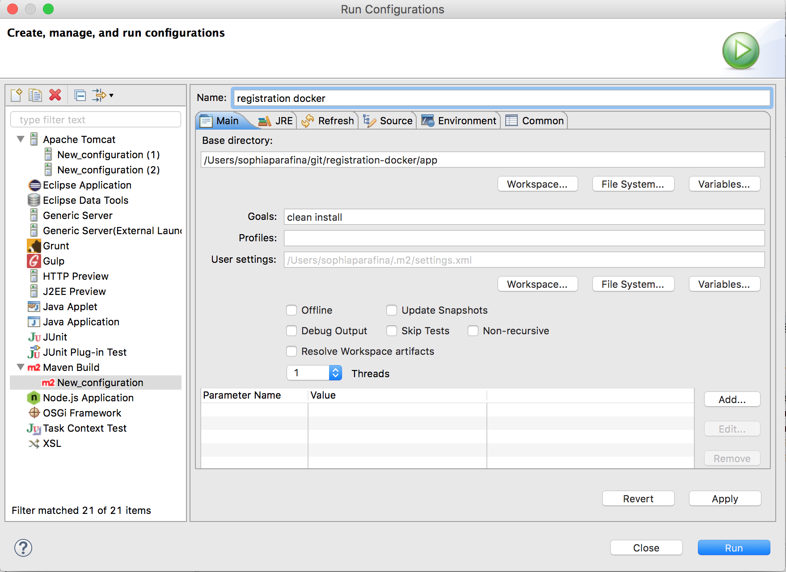
Building the Application
Notes:
Building the application
Click `Apply`Click `Run`
![](images/eclipse_maven_run_config_apply.png)
Running the application
Open a terminal and go to the application directory. Start the application with docker-compose
<pre>&gt; docker-compose up </pre>
Docker will build the images for Apache Tomcat and MySQL and start the containers. It will also mount the application directory (`./app/target/UserSignup`) as a data volume on the host system to the Tomcat webapps directory in the web server container.
Open a browser window and go to:
'localhost:8080'; you should see the Tomcat home page
![](images/tomcat_home3.png)
When the Tomcat image was built, the user roles were also configured. Click on the `Manager App` button to see the deployed applications. When prompted for username and password, enter `system` and `manager` respectively to log into the Tomcat Web Application Manager page.
![](images/tomcat_web_application_manager3.png)
You can use the Manager page to `Start`, `Stop`, `Reload` or `Undeploy` web applications.
To go to the application, Click on `/UserSignup` link.
![](images/app_index_page3.png)
Debugging the ApplicationIn the application, click on `Signup` to create a new user. Fill out the registration form and click `Submit`
![](images/app_debug_signup2.png)
Click `Yes` to confirm.
![](images/app_debug_signup_confirm.png)
Test out the login.
![](images/app_debug_login2.png)
Oh no!
![](images/app_debug_login_fail2.png)
Configure Remote
DebuggingTomcat supports remote debugging the Java Platform Debugger Architecture (JPDA). Remote debugging was enabled when the tomcat image (registration-webserver) was built.
To configure remote debugging in Eclipse, click on `Run` > `Debug Configurations ...
`![](images/eclipse_debug_configure2.png)
Select `Remote Java Application` and click on `Launch New Configuration` icon
![](images/eclipse_debug_configure_new.png)
Enter a `Name` for the configuration. Select the project using the `browse` button. Click on `Apply` to save the configuration and click on `Debug` to start the debugging connection between Tomcat and Eclipse.
![](images/eclipse_debug_configure_docker.png)
Finding the Error
Since the problem is with the password, lets see how the password is set in the User class. In the User class, the setter for password is scrambled using [rot13](https://en.wikipedia.org/wiki/ROT13) before it is saved to the database.
![](images/eclipse_debug_User_password.png)
Try registering a new user using the debugger. In Eclipse, change the view or Perspective to the debugger by clicking on `Window` > `Perspective` > `Open Perspective` > `Debug`
![](images/eclipse_debug_perspective.png)
Eclipse will switch to the debug perspective. Since we enable remote debugging earlier, you should see the Daemon Threads for Tomcat in the debug window. Set a breakpoint for in the User class where the password is set.
![](images/eclipse_debug_User_breakpoint.png)
Register a new user with the username of 'Moby' and with 'm0by' as the password, click `Submit`, click `yes`
![](images/app_register_moby2.png)
Eclipse will display the code at the breakpoint and the value of password in the variables window. Note that the value is `m0by`
![](images/eclipse_debug_User_moby.png)
Click on `resume` or press `F8` to let the code run.
![](images/eclipse_debug_resume.png)
Next, set a breakpoint on the getPassword in the User class to see the value returned for password. You can also toggle off the breakpoint for setPassword.
![](images/eclipse_debug_User_getPassword.png)
Try to log into the application. Look at the value for password in the Eclipse variables window, note that it is `z0ol` which is `m0by` using ROT13.
![](images/eclipse_debug_User_show_user.png)
In this MVC application the UserController uses the findByLogin method in the UserServiceImpl class which uses the findByUsername method to retrieve the information from the database. It then checks to see if the password from the form matches the user password. Since the password from the login form is not scrambled using ROT13, it does not match the user password and you cannot log into the application.
To fix this, apply ROT13 to the password by adding an import near the top of the file
```
import com.docker.UserSignup.util.Rot13
```
and replace the contents of `findByLogin` with
```
public boolean findByLogin(String userName, String password) {
User usr = userRepository.findByUserName(userName);
String passwd = Rot13.rot13(password);
if(usr != null && usr.getPassword().equals(passwd)) {
return true;
}
return false;
}
```
![](images/eclipse_debug_UserServiceImpl_code.png)
Set a breakpoint in UserServiceImpl on the findByLogin method. Log in again and look at the values for the breakpoint. The 'passwd' variable is `z0ol` which matches the password for the user moby.
![](images/eclipse_debug_UserServiceImpl_values.png)
Continue (`F8`) and you should successfully log in.
![](images/app_debug_success.png)
cc
SOURCE:
https://github.com/docker/labs/blob/master/developer-tools/java-debugging/Eclipse-README.md

Slide 14
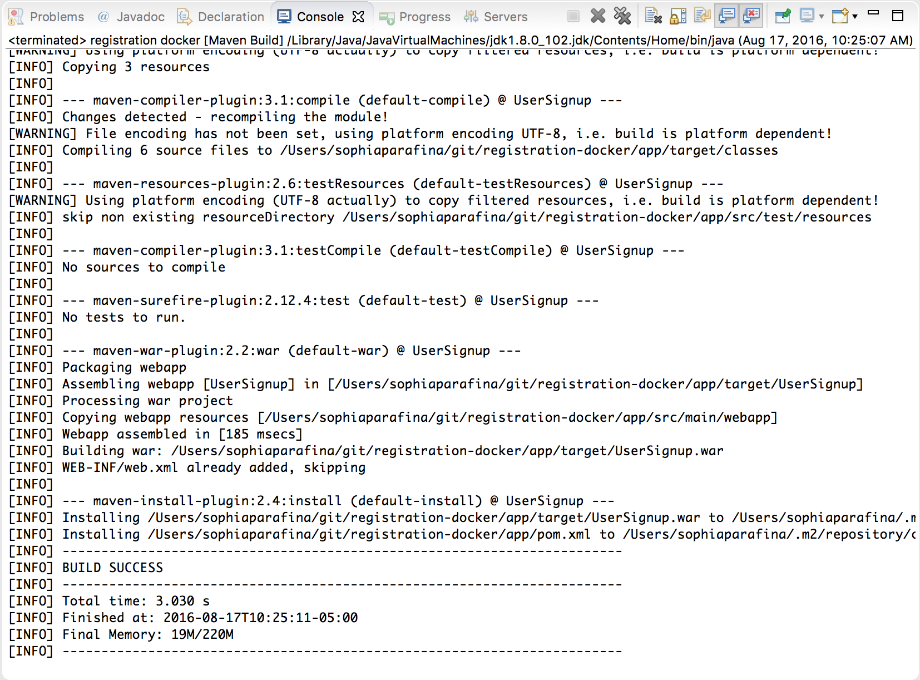
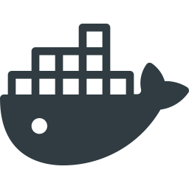
Building the Application
The results of the build will be displayed in the console
Notes:
Building the application
The results of the build will be displayed in the console.
![](images/eclipse_maven_console_build_result.png)
SOURCE:
https://github.com/docker/labs/blob/master/developer-tools/java-debugging/Eclipse-README.md

Slide 15
Running the Application
Open a terminal and go to the application directory
Start the application with Docker Compose:
Docker will build the images for Apache Tomcat and MySQL and start the containers
It will also mount the application directory as a data volume on the host system to the Tomcat webapps directory in the web server container
$ docker-compose up
Notes:
Running the application
Open a terminal and go to the application directory.
Start the application with docker-compose
$ docker-compose up
SHARE:
We will learn a lot more about Compose in a coming lecture, so don’t worry about understanding Compose, yet!
Docker will build the images for Apache Tomcat and MySQL and start the containers.
It will also mount the application directory (`./app/target/UserSignup`) as a data volume on the host system to the Tomcat webapps directory in the web server container.
SOURCE:
https://github.com/docker/labs/blob/master/developer-tools/java-debugging/Eclipse-README.md

Slide 16
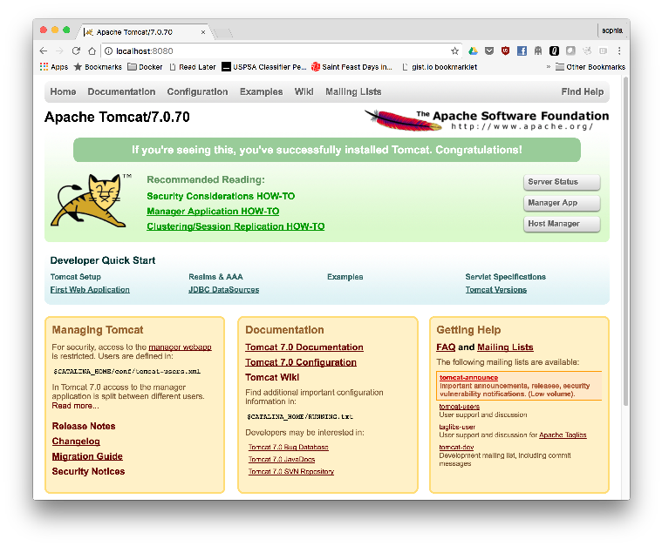
Running the Application
Open a browser window and go to: localhost:8080:
Look
Familiar?
Notes:
Running the application
Open a browser window and go to:
'localhost:8080'; you should see the Tomcat home page
![](images/tomcat_home3.png)
SOURCE:
https://github.com/docker/labs/blob/master/developer-tools/java-debugging/Eclipse-README.md

Slide 17
Running the Application
When the Tomcat image was built, the user roles were also configured
Click on the `Manager App` button to see the deployed applications
When prompted for username and password, enter `system` and `manager`
Let’s take a look...
Next,
Slide!
Notes:
Running the application
When the Tomcat image was built, the user roles were also configured.
Click on the `Manager App` button to see the deployed applications.
When prompted for username and password, enter `system` and `manager` respectively to log into the Tomcat Web Application Manager page.
![](images/tomcat_web_application_manager3.png)
SOURCE:
https://github.com/docker/labs/blob/master/developer-tools/java-debugging/Eclipse-README.md

Slide 18
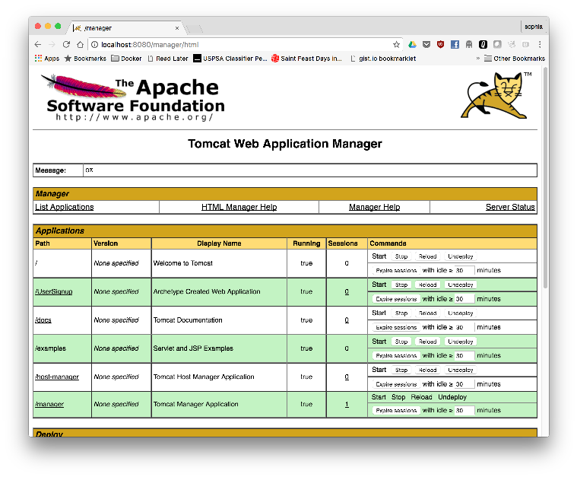
Running the Application
PURR
Notes:
Running the application
When the Tomcat image was built, the user roles were also configured.
Click on the `Manager App` button to see the deployed applications.
When prompted for username and password, enter `system` and `manager` respectively to log into the Tomcat Web Application Manager page.
![](images/tomcat_web_application_manager3.png)
SOURCE:
https://github.com/docker/labs/blob/master/developer-tools/java-debugging/Eclipse-README.md

Slide 19
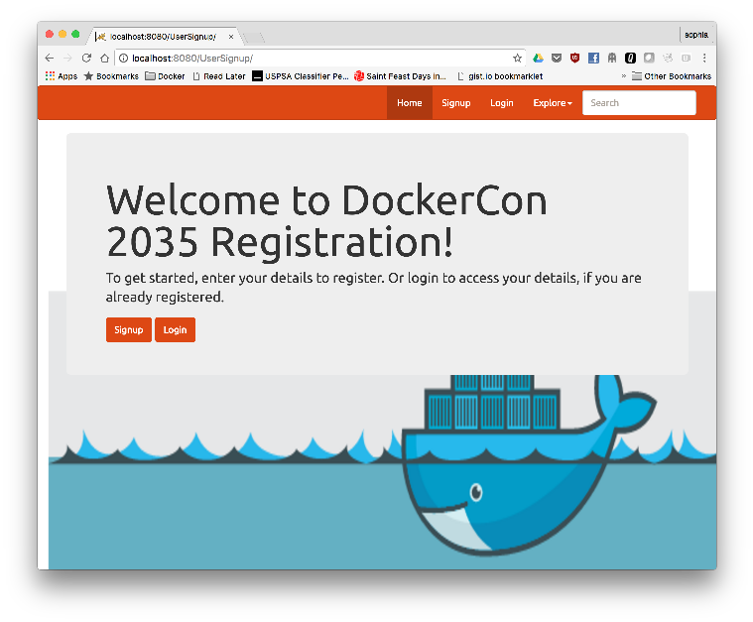
Running the Application
You can use the Manager page to `Start`, `Stop`, `Reload` or `Undeploy` web application
To go to the application, Click on `/UserSignup` link
Notes:
Running the application
You can use the Manager page to `Start`, `Stop`, `Reload` or `Undeploy` web applications.
To go to the application, Click on `/UserSignup` link.
![](images/app_index_page3.png)
SOURCE:
https://github.com/docker/labs/blob/master/developer-tools/java-debugging/Eclipse-README.md

Slide 20
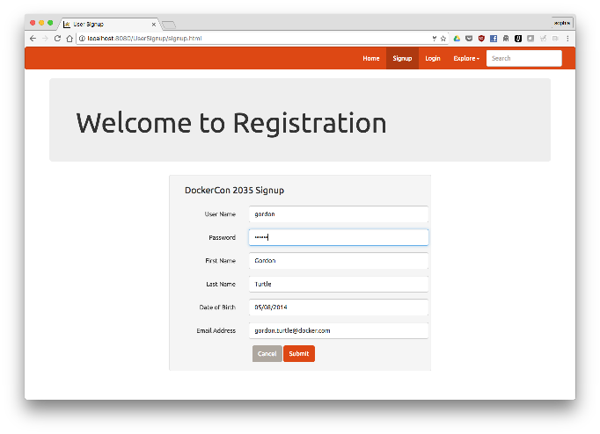
Running the Application
Debugging the ApplicationIn the application, click on `Signup` to create a new user.
Fill out the registration form and click `Submit`
Notes:
Running the application
Debugging the ApplicationIn the application, click on `Signup` to create a new user.
Fill out the registration form and click `Submit`
![](images/app_debug_signup2.png)
SOURCE:
https://github.com/docker/labs/blob/master/developer-tools/java-debugging/Eclipse-README.md

Slide 21
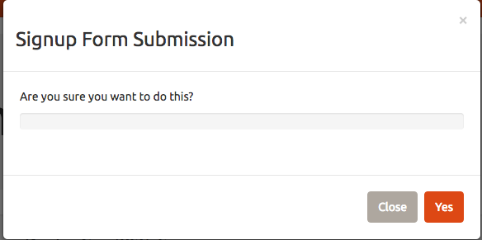
Running the Application
Click `Yes` to confirm.
Notes:
Running the application
Click `Yes` to confirm.
![](images/app_debug_signup_confirm.png)
SOURCE:
https://github.com/docker/labs/blob/master/developer-tools/java-debugging/Eclipse-README.md

Slide 22
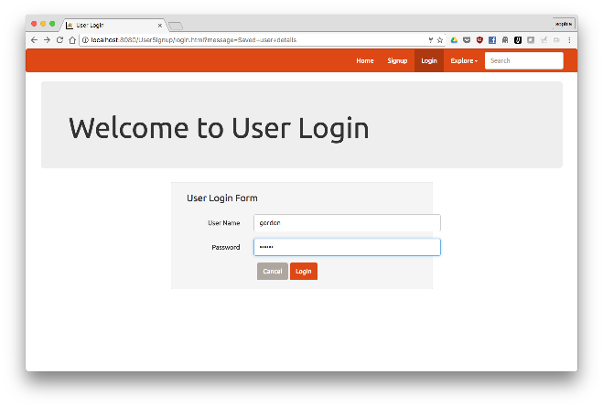
Running the Application
Test out the login.
Notes:
Running the application
Test out the login.
![](images/app_debug_login2.png)
SOURCE:
https://github.com/docker/labs/blob/master/developer-tools/java-debugging/Eclipse-README.md

Slide 23
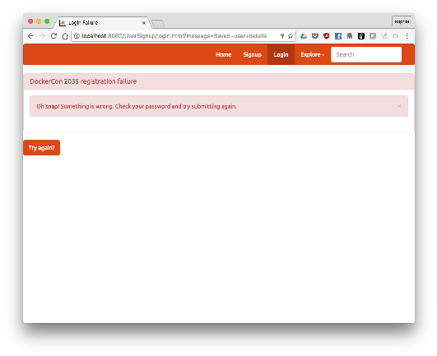
Running the Application
Oh no!
Notes:
Running the application
Oh no!
![](images/app_debug_login_fail2.png)
SOURCE:
https://github.com/docker/labs/blob/master/developer-tools/java-debugging/Eclipse-README.md

Slide 24
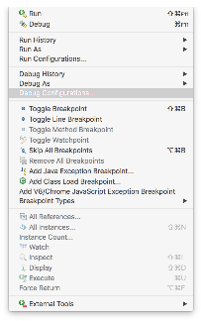
Configure Remote
DebuggingTomcat supports remote debugging the Java Platform Debugger Architecture (JPDA)
Remote debugging was enabled when the tomcat image (registration-webserver) was built.
To configure remote debugging in Eclipse, click on `Run` > `Debug Configurations ...
Notes:
Configure Remote
DebuggingTomcat supports remote debugging the Java Platform Debugger Architecture (JPDA).
Remote debugging was enabled when the tomcat image (registration-webserver) was built.
To configure remote debugging in Eclipse, click on `Run` > `Debug Configurations ...
`![](images/eclipse_debug_configure2.png)
SOURCE:
https://github.com/docker/labs/blob/master/developer-tools/java-debugging/Eclipse-README.md

Slide 25
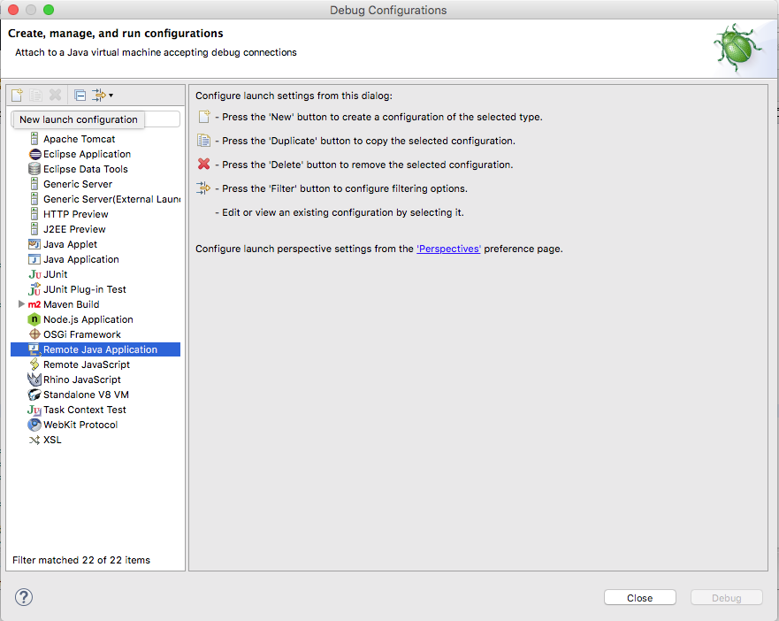
Configure Remote
Select `Remote Java Application` and click on `Launch New Configuration` icon
Notes:
Configure Remote
Select `Remote Java Application` and click on `Launch New Configuration` icon
![](images/eclipse_debug_configure_new.png)
SOURCE:
https://github.com/docker/labs/blob/master/developer-tools/java-debugging/Eclipse-README.md

Slide 26
Configure Remote
Enter a `Name` for the configuration
Select the project using the `browse` button
Click on `Apply` to save the configuration and click on `Debug` to start the debugging connection between Tomcat and Eclipse
Which, looks like this...
Next,
Slide!
Notes:
Configure Remote
Enter a `Name` for the configuration.
Select the project using the `browse` button.
Click on `Apply` to save the configuration and click on `Debug` to start the debugging connection between Tomcat and Eclipse.
![](images/eclipse_debug_configure_docker.png)
SOURCE:
https://github.com/docker/labs/blob/master/developer-tools/java-debugging/Eclipse-README.md

Slide 27
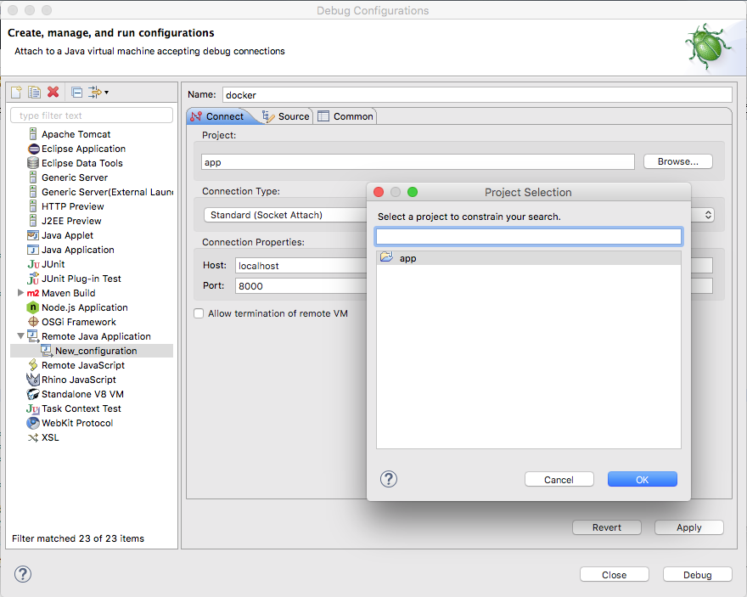
Configure Remote
Notes:
Configure Remote
![](images/eclipse_debug_configure_docker.png)
SOURCE:
https://github.com/docker/labs/blob/master/developer-tools/java-debugging/Eclipse-README.md

Slide 28
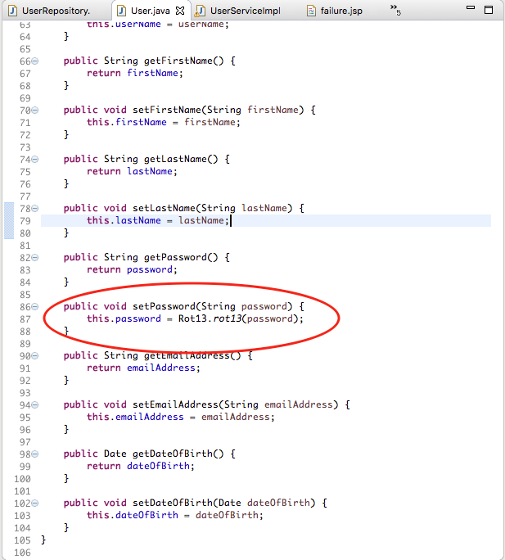
Finding the Error
Since the problem is with the password, lets see how the password is set in the User class
In the User class, the setter for password is scrambled using [rot13] before it is saved to the database
Notes:
Finding the Error
Since the problem is with the password, lets see how the password is set in the User class.
In the User class, the setter for password is scrambled using [rot13](https://en.wikipedia.org/wiki/ROT13) before it is saved to the database.
![](images/eclipse_debug_User_password.png)
SOURCE:
https://github.com/docker/labs/blob/master/developer-tools/java-debugging/Eclipse-README.md

Slide 29
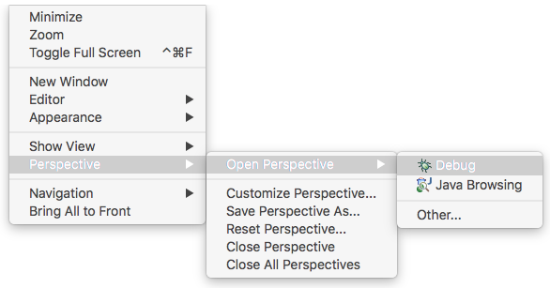
Finding the Error
Try registering a new user using the debugger
In Eclipse, change the view or Perspective to the debugger by clicking on `Window` > `Perspective` > `Open Perspective` > `Debug`
Notes:
Finding the Error
Try registering a new user using the debugger.
In Eclipse, change the view or Perspective to the debugger by clicking on `Window` > `Perspective` > `Open Perspective` > `Debug`
![](images/eclipse_debug_perspective.png)
SOURCE:
https://github.com/docker/labs/blob/master/developer-tools/java-debugging/Eclipse-README.md

Slide 30
Finding the Error
Eclipse will switch to the debug perspective
Since we enable remote debugging earlier, you should see the Daemon Threads for Tomcat in the debug window
Set a breakpoint for in the User class where the password is set
Let’s take a look at that now...
Next,
Slide!
Notes:
Finding the Error
Eclipse will switch to the debug perspective.
Since we enable remote debugging earlier, you should see the Daemon Threads for Tomcat in the debug window.
Set a breakpoint for in the User class where the password is set.
![](images/eclipse_debug_User_breakpoint.png)
SOURCE:
https://github.com/docker/labs/blob/master/developer-tools/java-debugging/Eclipse-README.md

Slide 31
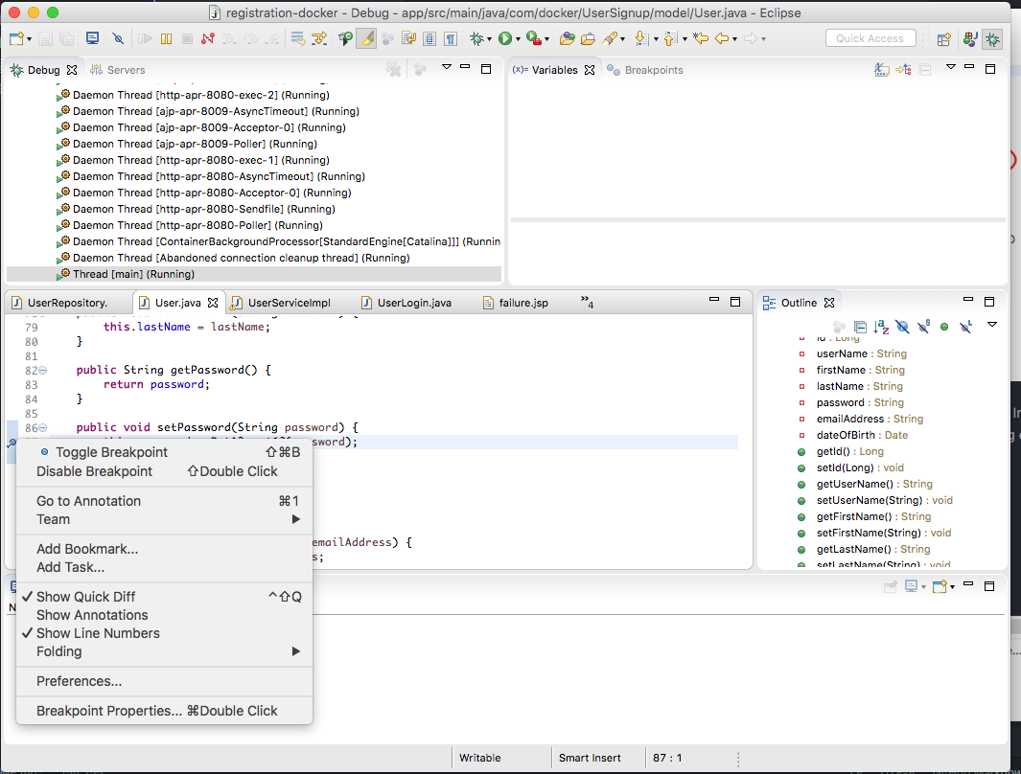
Finding the Error
Notes:
Finding the Error
![](images/eclipse_debug_User_breakpoint.png)
SOURCE:
https://github.com/docker/labs/blob/master/developer-tools/java-debugging/Eclipse-README.md

Slide 32
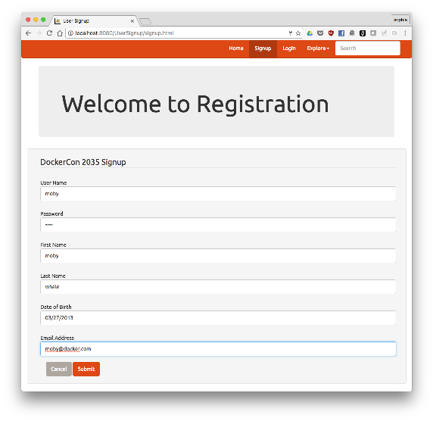
Finding the Error
Register a new user with the username of 'Moby' and with 'm0by' as the password, click `Submit`, click `yes`
Notes:
Finding the Error
Register a new user with the username of 'Moby' and with 'm0by' as the password, click `Submit`, click `yes`
![](images/app_register_moby2.png)
SOURCE:
https://github.com/docker/labs/blob/master/developer-tools/java-debugging/Eclipse-README.md

Slide 33
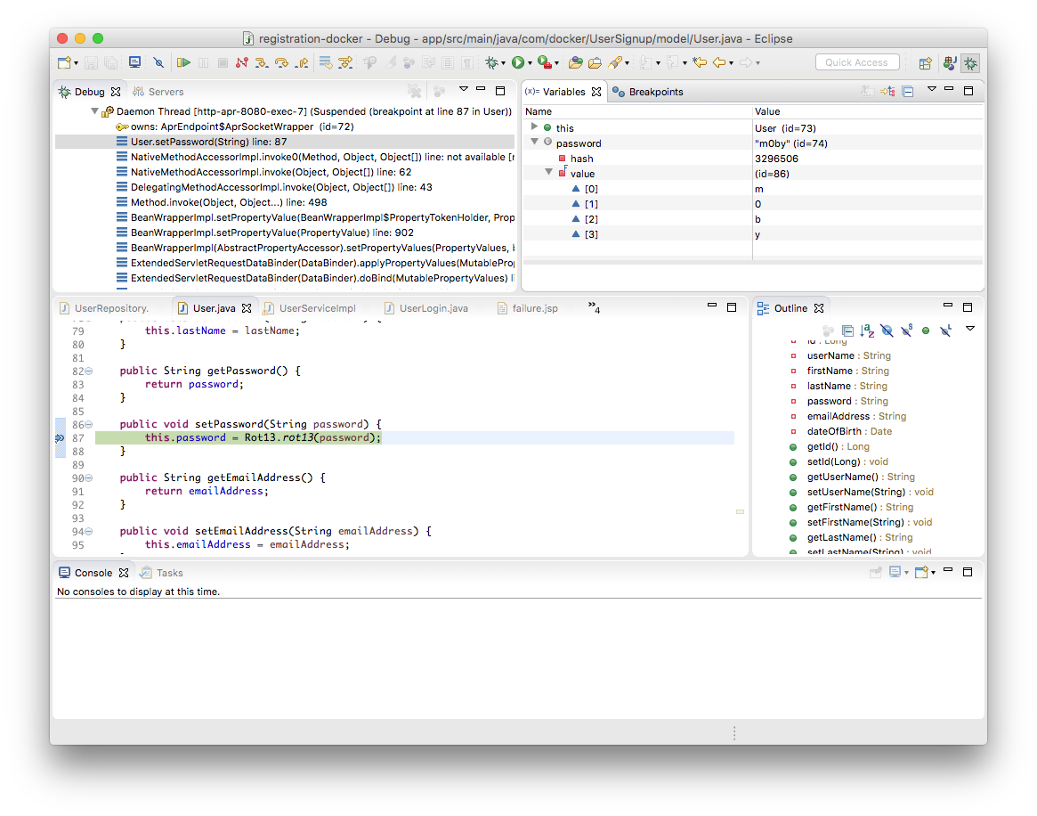
Finding the Error
Eclipse will display the code at the breakpoint and the value of password in the variables window.
Notes:
Finding the Error
Eclipse will display the code at the breakpoint and the value of password in the variables window.
SHARE:
Note that the value is `m0by`
![](images/eclipse_debug_User_moby.png)
SOURCE:
https://github.com/docker/labs/blob/master/developer-tools/java-debugging/Eclipse-README.md

Slide 34
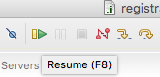
Finding the Error
Click on `resume` or press `F8` to let the code run
Next, set a breakpoint on the getPassword in the User class to see the value returned for password
You can also toggle off the breakpoint for setPassword
Which we’ll see on the next slide...
Next,
Slide!
Notes:
Finding the Error
Click on `resume` or press `F8` to let the code run.
![](images/eclipse_debug_resume.png)
Next, set a breakpoint on the getPassword in the User class to see the value returned for password. You can also toggle off the breakpoint for setPassword.
![](images/eclipse_debug_User_getPassword.png)
SOURCE:
https://github.com/docker/labs/blob/master/developer-tools/java-debugging/Eclipse-README.md

Slide 35
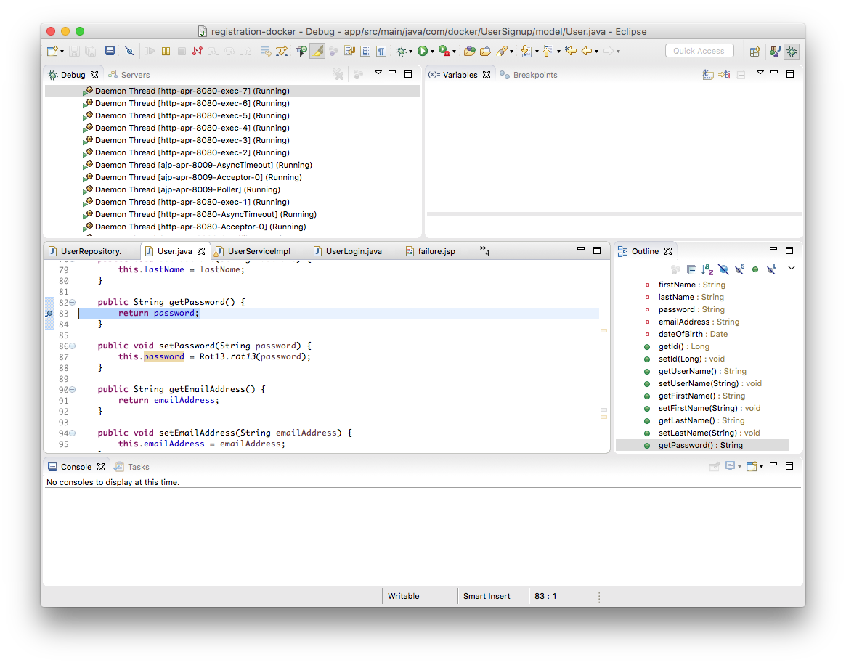
Finding the Error
Notes:
Finding the Error
![](images/eclipse_debug_User_getPassword.png)
SOURCE:
https://github.com/docker/labs/blob/master/developer-tools/java-debugging/Eclipse-README.md

Slide 36
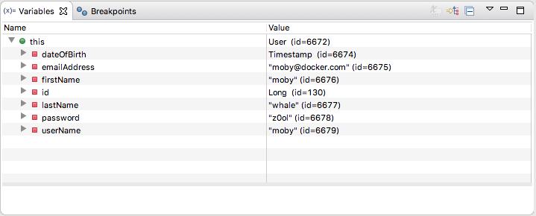
Finding the Error
Let’s try to log into the application
Look at the value for password in the Eclipse variables window, note that it is `z0ol` which is `m0by` using ROT13
Notes:
Finding the Error
Try to log into the application.
Look at the value for password in the Eclipse variables window, note that it is `z0ol` which is `m0by` using ROT13.
![](images/eclipse_debug_User_show_user.png)
SOURCE:
https://github.com/docker/labs/blob/master/developer-tools/java-debugging/Eclipse-README.md

Slide 37
Finding the Error
In this MVC application the UserController uses the findByLogin method in the UserServiceImpl class which uses the findByUsername method to retrieve the information from the database
It then checks to see if the password from the form matches the user password
Since the password from the login form is not scrambled using ROT13, it does not match the user password and you cannot log into the application
So, how do we fix this?
Notes:
Finding the Error
In this MVC application the UserController uses the findByLogin method in the UserServiceImpl class which uses the findByUsername method to retrieve the information from the database.
It then checks to see if the password from the form matches the user password.
Since the password from the login form is not scrambled using ROT13, it does not match the user password and you cannot log into the application.
SOURCE:
https://github.com/docker/labs/blob/master/developer-tools/java-debugging/Eclipse-README.md

Slide 38
Finding the Error
To fix this, apply ROT13 to the password by adding an import near the top of the file
And now, replace the contents of `findByLogin` with, the following:
import com.docker.UserSignup.util.Rot13
public boolean findByLogin(String userName, String password) {
User usr = userRepository.findByUserName(userName);
String passwd = Rot13.rot13(password);
if(usr != null && usr.getPassword().equals(passwd)) {
return true;
}
return false;
}
Next,
Slide!
Notes:
Finding the Error
![](images/eclipse_debug_UserServiceImpl_code.png)
SOURCE:
https://github.com/docker/labs/blob/master/developer-tools/java-debugging/Eclipse-README.md

Slide 39
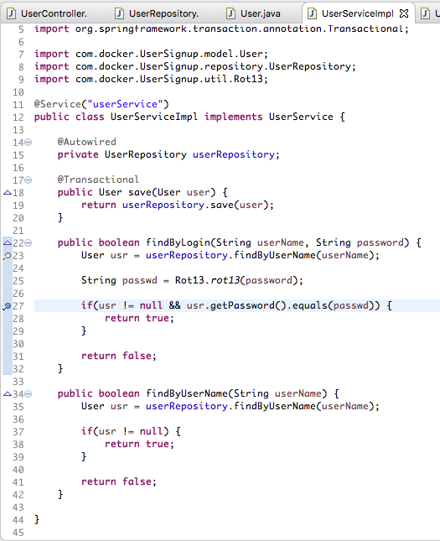
Finding the Error
Like,
That!
Notes:
Finding the Error
![](images/eclipse_debug_UserServiceImpl_code.png)
SOURCE:
https://github.com/docker/labs/blob/master/developer-tools/java-debugging/Eclipse-README.md

Slide 40
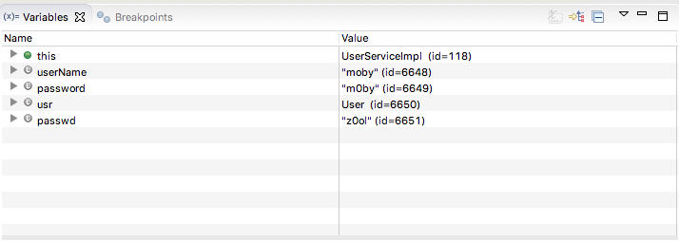
Finding the Error
Set a breakpoint in UserServiceImpl on the findByLogin method
Log in again and look at the values for the breakpoint
The 'passwd' variable is `z0ol` which matches the password for the user moby
Notes:
Finding the Error
Set a breakpoint in UserServiceImpl on the findByLogin method.
Log in again and look at the values for the breakpoint.
The 'passwd' variable is `z0ol` which matches the password for the user moby.
![](images/eclipse_debug_UserServiceImpl_values.png)
cc
SOURCE:
https://github.com/docker/labs/blob/master/developer-tools/java-debugging/Eclipse-README.md

Slide 41
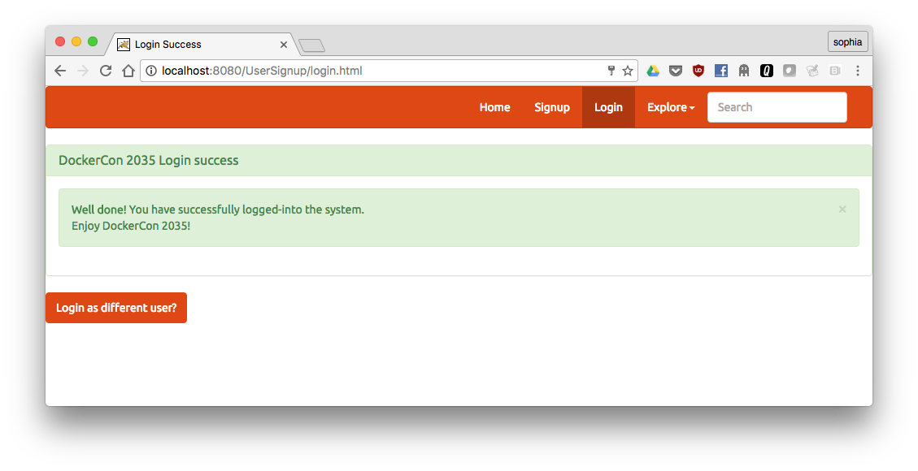

Finding the Error
Continue (`F8`) and you should successfully log in
Notes:
Finding the Error
Continue (`F8`) and you should successfully log in.
![](images/app_debug_success.png)
END
SOURCE:
https://github.com/docker/labs/blob/master/developer-tools/java-debugging/Eclipse-README.md

Slide 42
CI Jenkins Integration

Slide 43
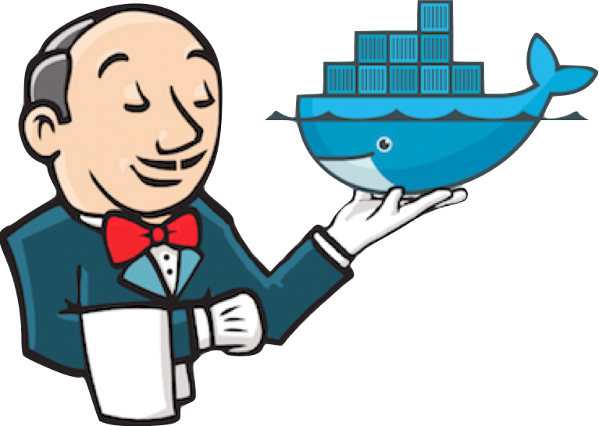
Jenkins Integration – Getting Started
Jenkins integrate very well with Docker!
We start by getting our Jenkins server up and running, using the following:
This will store the workspace in /var/jenkins_home
All Jenkins data lives in there!
$ docker run -p 8080:8080 -p 50000:50000 jenkins/jenkins:lts
Notes:
docker run -p 8080:8080 -p 50000:50000 jenkins/jenkins:lts
NOTE: read below the build executors part for the role of the 50000 port mapping.
This will store the workspace in /var/jenkins_home.
All Jenkins data lives in there
SHARE:
including plugins and configuration.
SOURCE:
https://github.com/jenkinsci/docker

Slide 44
Jenkins Integration - Volume
You will probably want to make that an explicit volume so you can manage it and attach to another container for upgrades :
Avoid using a bind mount from a folder on host into /var/jenkins_home, as this might result in file permission issue
If you really need to bind mount jenkins_home, ensure that directory on host is accessible by the jenkins user in container
$ docker run -p 8080:8080 -p 50000:50000 -v \
jenkins_home:/var/jenkins_home jenkins/jenkins:lts
Notes:
You will probably want to make that an explicit volume so you can manage it and attach to another container for upgrades :
docker run -p 8080:8080 -p 50000:50000 -v jenkins_home:/var/jenkins_home jenkins/jenkins:lts
SHARE:
this will automatically create a 'jenkins_home' volume on docker host, that will survive container stop/restart/deletion.
Avoid using a bind mount from a folder on host into /var/jenkins_home, as this might result in file permission issue.
If you really need to bind mount jenkins_home, ensure that directory on host is accessible by the jenkins user in container
SHARE:
(jenkins user - uid 1000) or use -u some_other_user parameter with docker run.
SOURCE:
https://github.com/jenkinsci/docker

Slide 45
Jenkins Integration - Backing Up Data
If you bind mount in a volume - you can simply back up that at any time
Treat the jenkins_home directory as you would a database
If your volume is inside a container - you can use docker cp $ID:/var/jenkins_home command to extract the data
Note that some symlinks on some OSes may be converted to copies
Notes:
Backing up data
If you bind mount in a volume - you can simply back up that directory (which is jenkins_home) at any time.
SHARE:
This is highly recommended.
Treat the jenkins_home directory as you would a database –
SHARE:
in Docker you would generally put a database on a volume.
If your volume is inside a container - you can use docker cp $ID:/var/jenkins_home command to extract the data,
SHARE:
or other options to find where the volume data is.
Note that some symlinks on some OSes may be converted to copies
SHARE:
(this can confuse jenkins with lastStableBuild links etc)
For more info check Docker docs section on Managing data in containers
SOURCE:
https://github.com/jenkinsci/docker

Slide 46
Jenkins Integration - Executors
You can specify and set the number of executors of your Jenkins master instance using a groovy script
By default its set to 2 executors, but you can extend the image and change it to your desired number of executors :
executors.groovy
and Dockerfile
import jenkins.model.* Jenkins.instance.setNumExecutors(5)
FROM jenkins/jenkins:lts
COPY executors.groovy /usr/share/jenkins/ref/init.groovy.d/executors.groovy
Notes:
Setting the number of executors
You can specify and set the number of executors of your Jenkins master instance using a groovy script.
By default its set to 2 executors, but you can extend the image and change it to your desired number of executors :
executors.groovy
import jenkins.model.* Jenkins.instance.setNumExecutors(5)
and Dockerfile
FROM jenkins/jenkins:lts
COPY executors.groovy /usr/share/jenkins/ref/init.groovy.d/executors.groovy
SHARE:
Attaching build executors
You can run builds on the master out of the box.
But if you want to attach build slave servers through JNLP (Java Web Start): make sure you map the port: -p 50000:50000 - which will be used when you connect a slave agent.
If you are only using SSH slaves, then you do NOT need to put that port mapping.
SOURCE:
https://github.com/jenkinsci/docker

Slide 47

Jenkins Integration - JVM Parameters
You might need to customize the JVM running Jenkins, typically to pass system properties or tweak heap memory settings
Use JAVA_OPTS environment variable for this purpose :
$ docker run --name myjenkins -p 8080:8080 -p 50000:50000 --env JAVA_OPTS=-Dhudson.footerURL=http://mycompany.com jenkins/jenkins:lts
Notes:
You might need to customize the JVM running Jenkins, typically to pass system properties or tweak heap memory settings.
Use JAVA_OPTS environment variable for this purpose :
docker run --name myjenkins -p 8080:8080 -p 50000:50000 --env JAVA_OPTS=-Dhudson.footerURL=http://mycompany.com jenkins/jenkins:lts
SOURCE:
https://github.com/jenkinsci/docker

Slide 48
Jenkins Integration - JVM Parameters
Jenkins logging can be configured through a properties file and java.util.logging.config.file Java property
For example:
$ mkdir data
$ cat > data/log.properties <<EOF
$ handlers=java.util.logging.ConsoleHandler
$ jenkins.level=FINEST
$ java.util.logging.ConsoleHandler.level=FINEST
EOF
$ docker run --name myjenkins -p 8080:8080 -p 50000:50000 \
--env JAVA_OPTS="-Djava.util.logging.config.file=/var/jenkins_home/log.properties” \
-v `pwd`/data:/var/jenkins_home jenkins/jenkins:lts \
Notes:
Jenkins logging can be configured through a properties file and java.util.logging.config.file Java property.
For example:
mkdir data
cat > data/log.properties <<EOF
handlers=java.util.logging.ConsoleHandler
jenkins.level=FINEST
java.util.logging.ConsoleHandler.level=FINEST
EOF
docker run --name myjenkins -p 8080:8080 -p 50000:50000 --env JAVA_OPTS="-Djava.util.logging.config.file=/var/jenkins_home/log.properties" -v `pwd`/data:/var/jenkins_home jenkins/jenkins:lts
SOURCE:
https://github.com/jenkinsci/docker

Slide 49
Jenkins Integration - Reverse Proxy
If you want to install Jenkins behind a reverse proxy with prefix, example:
mysite.com/jenkins,
You need to add environment variable JENKINS_OPTS="--prefix=/jenkins"
And then follow the documented procedures to configure your reverse proxy, which will depend if you having:
Apache
Or, Nginx
Notes:
If you want to install Jenkins behind a reverse proxy with prefix, example: mysite.com/jenkins, you need to add environment variable JENKINS_OPTS="--prefix=/jenkins" and then follow the below procedures to configure your reverse proxy, which will depend if you have Apache or Nginx:
Apache
Nginx
SOURCE:
https://github.com/jenkinsci/docker

Slide 50
Jenkins Integration - Launching Parameters
Argument you pass to docker running the jenkins image are passed to jenkins launcher, so you can run for sample:
You also can define jenkins arguments as JENKINS_OPTS
The following sample Dockerfile uses this option to force use of HTTPS with a certificate included in the image:
$ docker run jenkins/jenkins:lts --version
FROM jenkins/jenkins:lts
COPY https.pem /var/lib/jenkins/cert
COPY https.key /var/lib/jenkins/pk
ENV JENKINS_OPTS --httpPort=-1 --httpsPort=8083 --httpsCertificate=/var/lib/jenkins/cert --httpsPrivateKey=/var/lib/jenkins/pk
EXPOSE 8083
Notes:
Passing Jenkins launcher parameters
Argument you pass to docker running the jenkins image are passed to jenkins launcher, so you can run for sample :
docker run jenkins/jenkins:lts --version
SHARE:
This will dump Jenkins version, just like when you run jenkins as an executable war.
You also can define jenkins arguments as JENKINS_OPTS.
SHARE:
This is usefull to define a set of arguments to pass to jenkins launcher as you define a derived jenkins image based on the official one with some customized settings.
The following sample Dockerfile uses this option to force use of HTTPS with a certificate included in the image
FROM jenkins/jenkins:lts
COPY https.pem /var/lib/jenkins/cert
COPY https.key /var/lib/jenkins/pk
ENV JENKINS_OPTS --httpPort=-1 --httpsPort=8083 --httpsCertificate=/var/lib/jenkins/cert --httpsPrivateKey=/var/lib/jenkins/pk
EXPOSE 8083
SOURCE:
https://github.com/jenkinsci/docker

Slide 51
Jenkins Integration - Launching Parameters
You can also change the default slave agent port for jenkins by defining JENKINS_SLAVE_AGENT_PORT in a sample Dockerfile:
Or, as a parameter to docker,
FROM jenkins/jenkins:lts
ENV JENKINS_SLAVE_AGENT_PORT 50001
$ docker run --name myjenkins -p 8080:8080 -p 50001:50001 \
--env JENKINS_SLAVE_AGENT_PORT=50001 jenkins/jenkins:lts
Notes:
Passing Jenkins launcher parameters
You can also change the default slave agent port for jenkins by defining JENKINS_SLAVE_AGENT_PORT in a sample Dockerfile.
FROM jenkins/jenkins:lts
ENV JENKINS_SLAVE_AGENT_PORT 50001
or as a parameter to docker,
docker run --name myjenkins -p 8080:8080 -p 50001:50001 --env JENKINS_SLAVE_AGENT_PORT=50001 jenkins/jenkins:lts
SOURCE:
https://github.com/jenkinsci/docker

Slide 52
Jenkins Integration - Build
Build with the usual:
Tests are written using bats under the tests dir:
Bats can be easily installed with brew install bats on OS X
$ docker build -t jenkins/jenkins .
DOCKERFILE=Dockerfile bats tests
DOCKERFILE=Dockerfile-alpine bats tests
Notes:
Build with the usual
docker build -t jenkins/jenkins .
Tests are written using bats under the tests dir
DOCKERFILE=Dockerfile bats tests
DOCKERFILE=Dockerfile-alpine bats tests
Bats can be easily installed with brew install bats on OS X
SOURCE:
https://github.com/jenkinsci/docker

Slide 53
Monitoring Containers

Slide 54
Monitoring Containers
There are several common, simple ways to monitor containers
Docker CLI
One of the first monitor tactics is learn early, when we learn to run docker stat!
The output is continually updated; It shows:
Container name
Percent CPU utilization
Total memory usage vs amount available to the container
Percent memory utilization
Network activity
Disk activity
PIDS??
Notes:
SOURCE:
https://github.com/docker/labs/blob/master/developer-tools/java/chapters/ch10-monitoring.adoc
Prometheus
Docker metrics for Prometheus
Node health
Query using PromQL (TODO)
cAdvisor
Prometheus and cAdvisor
Monitor Java Applications
Start Java application
Start Prometheus service
View application metrics

Slide 55
Monitoring Containers
Doc
$ template
xx.xxx.xx.x
Notes:
SOURCE:
https://github.com/docker/labs/blob/master/developer-tools/java/chapters/ch10-monitoring.adoc
Prometheus
Docker metrics for Prometheus
Node health
Query using PromQL (TODO)
cAdvisor
Prometheus and cAdvisor
Monitor Java Applications
Start Java application
Start Prometheus service
View application metrics

Slide 56
Monitoring Containers
Docker Remote API
Docker Remote API provides a lot more details about the health of the container
It can be invoked using the following format:
On Docker for Mac, enabling remote HTTP API still requires a few steps
So this command uses the --unix-socket option to invoke the Remote API.
$ curl --unix-socket /var/run/docker.sock \
http://localhost/containers/<name>/stats
Notes:
Docker Remote API
Docker Remote API provides a lot more details about the health of the container.
It can be invoked using the following format:
curl --unix-socket /var/run/docker.sock http://localhost/containers/<name>/stats
On Docker for Mac, enabling remote HTTP API still requires a few steps.
So this command uses the --unix-socket option to invoke the Remote API.
A specific invocation for a container can be done as:
curl --unix-socket /var/run/docker.sock http://localhost/containers/web.1.bg1dcwagl9tzz0azuegxzoys8/stats
Note, the container name is from the previous run of the service.
It will show the output:
{"read":"2017-10-13T14:08:38.045217731Z","preread":"0001-01-01T00:00:00Z","pids_stats":{"current":51},"blkio_stats":{"io_service_bytes_recursive":[{"major":8,"minor":0,"op":"Read","value":0},{"major":8,"minor":0,"op":"Write","value":4096},{"major":8,"minor":0,"op":"Sync","value":0},{"major":8,"minor":0,"op":"Async","value":4096},{"major":8,"minor":0,"op":"Total","value":4096}],"io_serviced_recursive":[{"major":8,"minor":0,"op":"Read","value":0},{"major":8,"minor":0,"op":"Write","value":1},{"major":8,"minor":0,"op":"Sync","value":0},{"major":8,"minor":0,"op":"Async","value":1},{"major":8,"minor":0,"op":"Total","value":1}],"io_queue_recursive":[],"io_service_time_recursive":[],"io_wait_time_recursive":[],"io_merged_recursive":[],"io_time_recursive":[],"sectors_recursive":[]},"num_procs":0,"storage_stats":{},"cpu_stats":{"cpu_usage":{"total_usage":11130296115,"percpu_usage":[2687118654,3014514615,2971860160,2456802686],"usage_in_kernelmode":2700000000,"usage_in_usermode":7630000000},"system_cpu_usage":952826800000000,"online_cpus":4,"throttling_data":{"periods":0,"throttled_periods":0,"throttled_time":0}},"precpu_stats":{"cpu_usage":{"total_usage":0,"usage_in_kernelmode":0,"usage_in_usermode":0},"throttling_data":{"periods":0,"throttled_periods":0,"throttled_time":0}},"memory_stats":{"usage":288051200,"max_usage":297189376,"stats":{"active_anon":283893760,"active_file":0,"cache":135168,"dirty":16384,"hierarchical_memory_limit":9223372036854771712,"hierarchical_memsw_limit":9223372036854771712,"inactive_anon":0,"inactive_file":135168,"mapped_file":32768,"pgfault":83204,"pgmajfault":0,"pgpgin":78441,"pgpgout":9093,"rss":283914240,"rss_huge":0,"swap":0,"total_active_anon":283893760,"total_active_file":0,"total_cache":135168,"total_dirty":16384,"total_inactive_anon":0,"total_inactive_file":135168,"total_mapped_file":32768,"total_pgfault":83204,"total_pgmajfault":0,"total_pgpgin":78441,"total_pgpgout":9093,"total_rss":283914240,"total_rss_huge":0,"total_swap":0,"total_unevictable":0,"total_writeback":0,"unevictable":0,"writeback":0},"limit":2095874048},"name":"/web.1.bg1dcwagl9tzz0azuegxzoys8","id":"6e98a9597e6af085e73a4d211fff9a164aa012727a46525d4fbaa164b572e23f","networks":{"eth0":{"rx_bytes":1882,"rx_packets":37,"rx_errors":0,"rx_dropped":0,"tx_bytes":0,"tx_packets":0,"tx_errors":0,"tx_dropped":0}}}
As you can see, far more details about container’s health are shown here. These stats are refereshed every one second. The continuous refresh of metrics can be terminated using Ctrl + C.
SOURCE:
https://github.com/docker/labs/blob/master/developer-tools/java/chapters/ch10-monitoring.adoc
Prometheus
Docker metrics for Prometheus
Node health
Query using PromQL (TODO)
cAdvisor
Prometheus and cAdvisor
Monitor Java Applications
Start Java application
Start Prometheus service
View application metrics

Slide 57
Monitoring Containers
Docker Remote API
A specific invocation for a container can be done as:
It will show the output:
$ curl --unix-socket /var/run/docker.sock
http://localhost/containers/web.1.bg1dcwagl9tzz0azuegxzoys8/stats
{"read":"2017-10-13T14:08:38.045217731Z","preread":"0001-01-01T00:00:00Z","pids_stats":{"current":51},"blkio_stats":{"io_service_bytes_recursive":[{"major":8,"minor":0,"op":"Read","value":0},{"major":8,"minor":0,"op":"Write","value":4096},{"major":8,"minor":0,"op":"Sync","value":0},{"major":8,"minor":0,"op":"Async","value":4096},{"major":8,"minor":0,"op":"Total","value":4096}],"io_serviced_recursive":[{"major":8,"minor":0,"op":"Read","value":0},{"major":8,"minor":0,"op":"Write","value":1},{"major":8,"minor":0,"op":"Sync","value":0},{"major":8,"minor":0,"op":"Async","value":1},{"major":8,"minor":0,"op":"Total","value":1}],"io_queue_recursive":[],"io_service_time_recursive":[],"io_wait_time_recursive":[],"io_merged_recursive":[],"io_time_recursive":[],"sectors_recursive":[]},"num_procs":0,"storage_stats":{},"cpu_stats":{"cpu_usage. . .
Reference: cs_07-57.bash
Notes:
Docker Remote API
A specific invocation for a container can be done as:
curl --unix-socket /var/run/docker.sock http://localhost/containers/web.1.bg1dcwagl9tzz0azuegxzoys8/stats
SHARE:
Note, the container name is from the previous run of the service.
It will show the output:
REFERENCE: cs_07-57.bash for entire snippet
{"read":"2017-10-13T14:08:38.045217731Z","preread":"0001-01-01T00:00:00Z","pids_stats":{"current":51},"blkio_stats":{"io_service_bytes_recursive":[{"major":8,"minor":0,"op":"Read","value":0},{"major":8,"minor":0,"op":"Write","value":4096},{"major":8,"minor":0,"op":"Sync","value":0},{"major":8,"minor":0,"op":"Async","value":4096},{"major":8,"minor":0,"op":"Total","value":4096}],"io_serviced_recursive":[{"major":8,"minor":0,"op":"Read","value":0},{"major":8,"minor":0,"op":"Write","value":1},{"major":8,"minor":0,"op":"Sync","value":0},{"major":8,"minor":0,"op":"Async","value":1},{"major":8,"minor":0,"op":"Total","value":1}],"io_queue_recursive":[],"io_service_time_recursive":[],"io_wait_time_recursive":[],"io_merged_recursive":[],"io_time_recursive":[],"sectors_recursive":[]},"num_procs":0,"storage_stats":{},"cpu_stats":{"cpu_usage":{"total_usage":11130296115,"percpu_usage":[2687118654,3014514615,2971860160,2456802686],"usage_in_kernelmode":2700000000,"usage_in_usermode":7630000000},"system_cpu_usage":952826800000000,"online_cpus":4,"throttling_data":{"periods":0,"throttled_periods":0,"throttled_time":0}},"precpu_stats":{"cpu_usage":{"total_usage":0,"usage_in_kernelmode":0,"usage_in_usermode":0},"throttling_data":{"periods":0,"throttled_periods":0,"throttled_time":0}},"memory_stats":{"usage":288051200,"max_usage":297189376,"stats":{"active_anon":283893760,"active_file":0,"cache":135168,"dirty":16384,"hierarchical_memory_limit":9223372036854771712,"hierarchical_memsw_limit":9223372036854771712,"inactive_anon":0,"inactive_file":135168,"mapped_file":32768,"pgfault":83204,"pgmajfault":0,"pgpgin":78441,"pgpgout":9093,"rss":283914240,"rss_huge":0,"swap":0,"total_active_anon":283893760,"total_active_file":0,"total_cache":135168,"total_dirty":16384,"total_inactive_anon":0,"total_inactive_file":135168,"total_mapped_file":32768,"total_pgfault":83204,"total_pgmajfault":0,"total_pgpgin":78441,"total_pgpgout":9093,"total_rss":283914240,"total_rss_huge":0,"total_swap":0,"total_unevictable":0,"total_writeback":0,"unevictable":0,"writeback":0},"limit":2095874048},"name":"/web.1.bg1dcwagl9tzz0azuegxzoys8","id":"6e98a9597e6af085e73a4d211fff9a164aa012727a46525d4fbaa164b572e23f","networks":{"eth0":{"rx_bytes":1882,"rx_packets":37,"rx_errors":0,"rx_dropped":0,"tx_bytes":0,"tx_packets":0,"tx_errors":0,"tx_dropped":0}}}
SHARE:
As you can see, far more details about container’s health are shown here.
These stats are refereshed every one second.
The continuous refresh of metrics can be terminated using Ctrl + C.
SOURCE:
https://github.com/docker/labs/blob/master/developer-tools/java/chapters/ch10-monitoring.adoc
Prometheus
Docker metrics for Prometheus
Node health
Query using PromQL (TODO)
cAdvisor
Prometheus and cAdvisor
Monitor Java Applications
Start Java application
Start Prometheus service
View application metrics

Slide 58
Prometheus
Prometheus
Prometheus is an open-source systems monitoring and alerting toolkit
Docker instance can be configured as Prometheus target
Different targets to scrape are defined in the Prometheus configuration file
Prometheus collects metrics from monitored targets by scraping metrics from HTTP endpoints on these targets
Since Prometheus also exposes data in the same manner about itself, it can also scrape and monitor its own health
Notes:
Prometheus
Prometheus is an open-source systems monitoring and alerting toolkit.
SHARE:
Prometheus collects metrics from monitored targets by scraping metrics from HTTP endpoints on these targets.
Docker instance can be configured as Prometheus target.
Different targets to scrape are defined in the Prometheus configuration file.
SHARE:
Targets may be statically configured via the static_configs parameter in the configuration fle or dynamically discovered using one of the supported service-discovery mechanisms (Consul, DNS, Etcd, etc.).
Prometheus collects metrics from monitored targets by scraping metrics from HTTP endpoints on these targets.
Since Prometheus also exposes data in the same manner about itself, it can also scrape and monitor its own health.
SOURCE:
https://github.com/docker/labs/blob/master/developer-tools/java/chapters/ch10-monitoring.adoc
Prometheus
Docker metrics for Prometheus
Node health
Query using PromQL (TODO)
cAdvisor
Prometheus and cAdvisor
Monitor Java Applications
Start Java application
Start Prometheus service
View application metrics

Slide 59
Prometheus
Docker exposes Prometheus-compatible metrics on port 9323
This support is only available as an experimental feature
For Docker for Mac, click on Docker icon in the status menu
Select Preferences…​, Daemon, Advanced tab
Update daemon settings:
Click on Apply & Restart to restart the daemon
Let’s take a look...
{
"metrics-addr" : "0.0.0.0:9323",
"experimental" : true
}
Next,
Slide!
Notes:
Docker metrics for Prometheus
Docker exposes Prometheus-compatible metrics on port 9323. This support is only available as an experimental feature.
1. For Docker for Mac, click on Docker icon in the status menu
2. Select Preferences…​, Daemon, Advanced tab
3. Update daemon settings:
{ "metrics-addr" : "0.0.0.0:9323", "experimental" : true }
4. Click on Apply & Restart to restart the daemon
PICTURE ON NEXT SLIDE
SOURCE:
https://github.com/docker/labs/blob/master/developer-tools/java/chapters/ch10-monitoring.adoc
Prometheus
Docker metrics for Prometheus
Node health
Query using PromQL (TODO)
cAdvisor
Prometheus and cAdvisor
Monitor Java Applications
Start Java application
Start Prometheus service
View application metrics

Slide 60
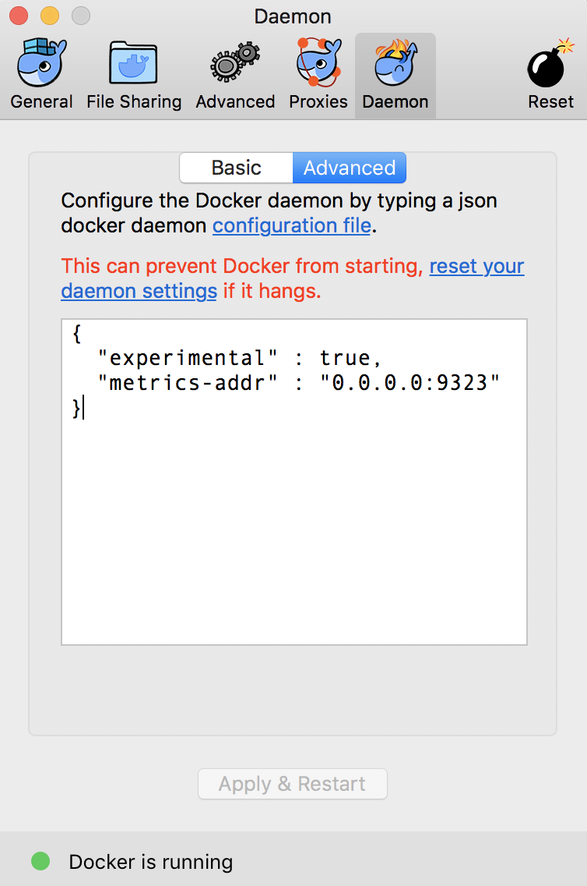
Prometheus
Notes:
Docker metrics for Prometheus
prometheus-metrics-config.png
SOURCE:
https://github.com/docker/labs/blob/master/developer-tools/java/chapters/ch10-monitoring.adoc
Prometheus
Docker metrics for Prometheus
Node health
Query using PromQL (TODO)
cAdvisor
Prometheus and cAdvisor
Monitor Java Applications
Start Java application
Start Prometheus service
View application metrics

Slide 61
Prometheus
Prometheus
Final steps:
Show the complete list of metrics using curl http://localhost:9323/metrics
Show the list of engine metrics using curl http://localhost:9323/metrics | grep engine
Notes:
Docker metrics for Prometheus
(Steps are a continuation from #59)
Show the complete list of metrics using curl http://localhost:9323/metrics
Show the list of engine metrics using curl http://localhost:9323/metrics | grep engine
SOURCE:
https://github.com/docker/labs/blob/master/developer-tools/java/chapters/ch10-monitoring.adoc
Prometheus
Docker metrics for Prometheus
Node health
Query using PromQL (TODO)
cAdvisor
Prometheus and cAdvisor
Monitor Java Applications
Start Java application
Start Prometheus service
View application metrics

Slide 62
Prometheus
In this section, we’ll start Prometheus and use it to scrape it’s own health
Create a new directory prometheus and change to that directory
Create a text file prometheus.yml and use the following content
This configuration file scrapes data from the Prometheus container which will be started subsequently on port 9090
# A scrape configuration scraping a Node Exporter and the Prometheus server
# itself.
scrape_configs:
# Scrape Prometheus itself every 5 seconds.
- job_name: 'prometheus'
scrape_interval: 5s
static_configs:
- targets: ['localhost:9090']
Notes:
Docker metrics for Prometheus
Start Prometheus
In this section, we’ll start Prometheus and use it to scrape it’s own health.
Create a new directory prometheus and change to that directory
Create a text file prometheus.yml and use the following content
# A scrape configuration scraping a Node Exporter and the Prometheus server
# itself.
scrape_configs:
# Scrape Prometheus itself every 5 seconds.
- job_name: 'prometheus'
scrape_interval: 5s
static_configs:
- targets: ['localhost:9090']
This configuration file scrapes data from the Prometheus container which will be started subsequently on port 9090.
Start a single-replica Prometheus service:
docker service create \
--replicas 1 \
--name metrics \
--mount type=bind,source=`pwd`/prometheus.yml,destination=/etc/prometheus/prometheus.yml \
--publish 9090:9090/tcp \
prom/prometheus
This will start the Prometheus container on port 9090.
4.Prometheus dashboard is at http://localhost:9090. Check the list of enabled targets at http://localhost:9090/targets(also accessible from Status → Targets menu).
prometheus-metrics-target.png
It shows that the Prometheus endpoint is available for scraping.
5.Click on Graph and click on -insert metric at cursor- to see the list of metrics available:
prometheus-metrics1.png
(lrg)
These are all the metrics published by the Prometheus endpoint.
6.Choose http_request_total metrics, click on Execute
prometheus-metrics2.png
7.Switch from Console to Graph
prometheus-metrics3.png
8.Change the duration from 1h to 5m
prometheus-metrics4.png
9.Click on Add Graph, select a different metric, say http_requests_duration_microseconds, and click on Execute
prometheus-metrics5.png
10.Switch from Console to Graph and change the duration from 1h to 5m
prometheus-metrics6.png
11.Stop the container: docker container rm -f metrics
Multiple graphs can be added this way.
SOURCE:
https://github.com/docker/labs/blob/master/developer-tools/java/chapters/ch10-monitoring.adoc
Prometheus
Docker metrics for Prometheus
Node health
Query using PromQL (TODO)
cAdvisor
Prometheus and cAdvisor
Monitor Java Applications
Start Java application
Start Prometheus service
View application metrics

Slide 63
Prometheus
Start a single-replica Prometheus service:
This will start the Prometheus container on port 9090.
$ docker service create \
--replicas 1 \
--name metrics \
--mount type=bind,source=`pwd`/prometheus.yml,destination=/etc/prometheus/prometheus.yml \
--publish 9090:9090/tcp \
prom/prometheus
Notes:
Docker metrics for Prometheus
Start Prometheus
4.Prometheus dashboard is at http://localhost:9090.
SHARE:
Check the list of enabled targets at http://localhost:9090/targets(also accessible from Status → Targets menu).
prometheus-metrics-target.png
It shows that the Prometheus endpoint is available for scraping.
5.Click on Graph and click on -insert metric at cursor- to see the list of metrics available:
prometheus-metrics1.png
(lrg)
These are all the metrics published by the Prometheus endpoint.
6.Choose http_request_total metrics, click on Execute
prometheus-metrics2.png
7.Switch from Console to Graph
prometheus-metrics3.png
8.Change the duration from 1h to 5m
prometheus-metrics4.png
9.Click on Add Graph, select a different metric, say http_requests_duration_microseconds, and click on Execute
prometheus-metrics5.png
10.Switch from Console to Graph and change the duration from 1h to 5m
prometheus-metrics6.png
11.Stop the container: docker container rm -f metrics
Multiple graphs can be added this way.
SOURCE:
https://github.com/docker/labs/blob/master/developer-tools/java/chapters/ch10-monitoring.adoc
Prometheus
Docker metrics for Prometheus
Node health
Query using PromQL (TODO)
cAdvisor
Prometheus and cAdvisor
Monitor Java Applications
Start Java application
Start Prometheus service
View application metrics

Slide 64
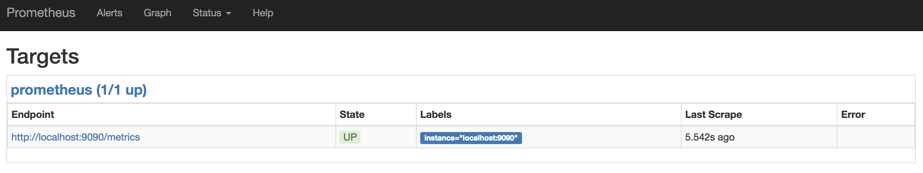
Prometheus
Prometheus dashboard is at http://localhost:9090
It shows that the Prometheus endpoint is available for scraping
Click on Graph and click on -insert metric at cursor- to see the list of metrics available:
Next,
Slide!
Notes:
Docker metrics for Prometheus
Start Prometheus
4.Prometheus dashboard is at http://localhost:9090.
SHARE:
Check the list of enabled targets at http://localhost:9090/targets(also accessible from Status → Targets menu).
prometheus-metrics-target.png
It shows that the Prometheus endpoint is available for scraping.
5.Click on Graph and click on -insert metric at cursor- to see the list of metrics available:
prometheus-metrics1.png
(lrg)
These are all the metrics published by the Prometheus endpoint.
6.Choose http_request_total metrics, click on Execute
prometheus-metrics2.png
7.Switch from Console to Graph
prometheus-metrics3.png
8.Change the duration from 1h to 5m
prometheus-metrics4.png
9.Click on Add Graph, select a different metric, say http_requests_duration_microseconds, and click on Execute
prometheus-metrics5.png
10.Switch from Console to Graph and change the duration from 1h to 5m
prometheus-metrics6.png
11.Stop the container: docker container rm -f metrics
Multiple graphs can be added this way.
SOURCE:
https://github.com/docker/labs/blob/master/developer-tools/java/chapters/ch10-monitoring.adoc
Prometheus
Docker metrics for Prometheus
Node health
Query using PromQL (TODO)
cAdvisor
Prometheus and cAdvisor
Monitor Java Applications
Start Java application
Start Prometheus service
View application metrics

Slide 65
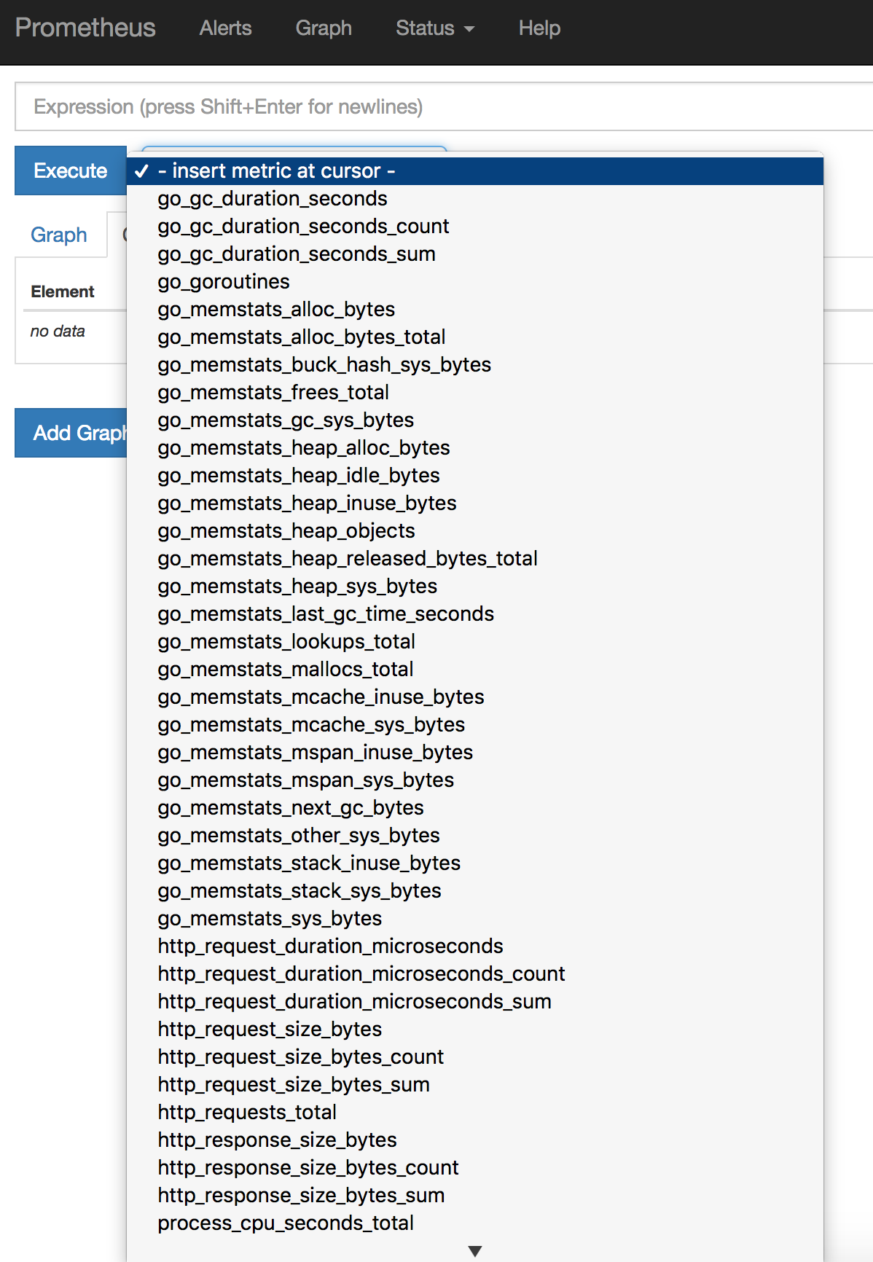
Prometheus
These are all the metrics published by the Prometheus endpoint
Notes:
Docker metrics for Prometheus
Start Prometheus
5.Click on Graph and click on -insert metric at cursor- to see the list of metrics available:
prometheus-metrics1.png
(lrg)
These are all the metrics published by the Prometheus endpoint.
6.Choose http_request_total metrics, click on Execute
prometheus-metrics2.png
7.Switch from Console to Graph
prometheus-metrics3.png
8.Change the duration from 1h to 5m
prometheus-metrics4.png
9.Click on Add Graph, select a different metric, say http_requests_duration_microseconds, and click on Execute
prometheus-metrics5.png
10.Switch from Console to Graph and change the duration from 1h to 5m
prometheus-metrics6.png
11.Stop the container: docker container rm -f metrics
Multiple graphs can be added this way.
SOURCE:
https://github.com/docker/labs/blob/master/developer-tools/java/chapters/ch10-monitoring.adoc
Prometheus
Docker metrics for Prometheus
Node health
Query using PromQL (TODO)
cAdvisor
Prometheus and cAdvisor
Monitor Java Applications
Start Java application
Start Prometheus service
View application metrics

Slide 66
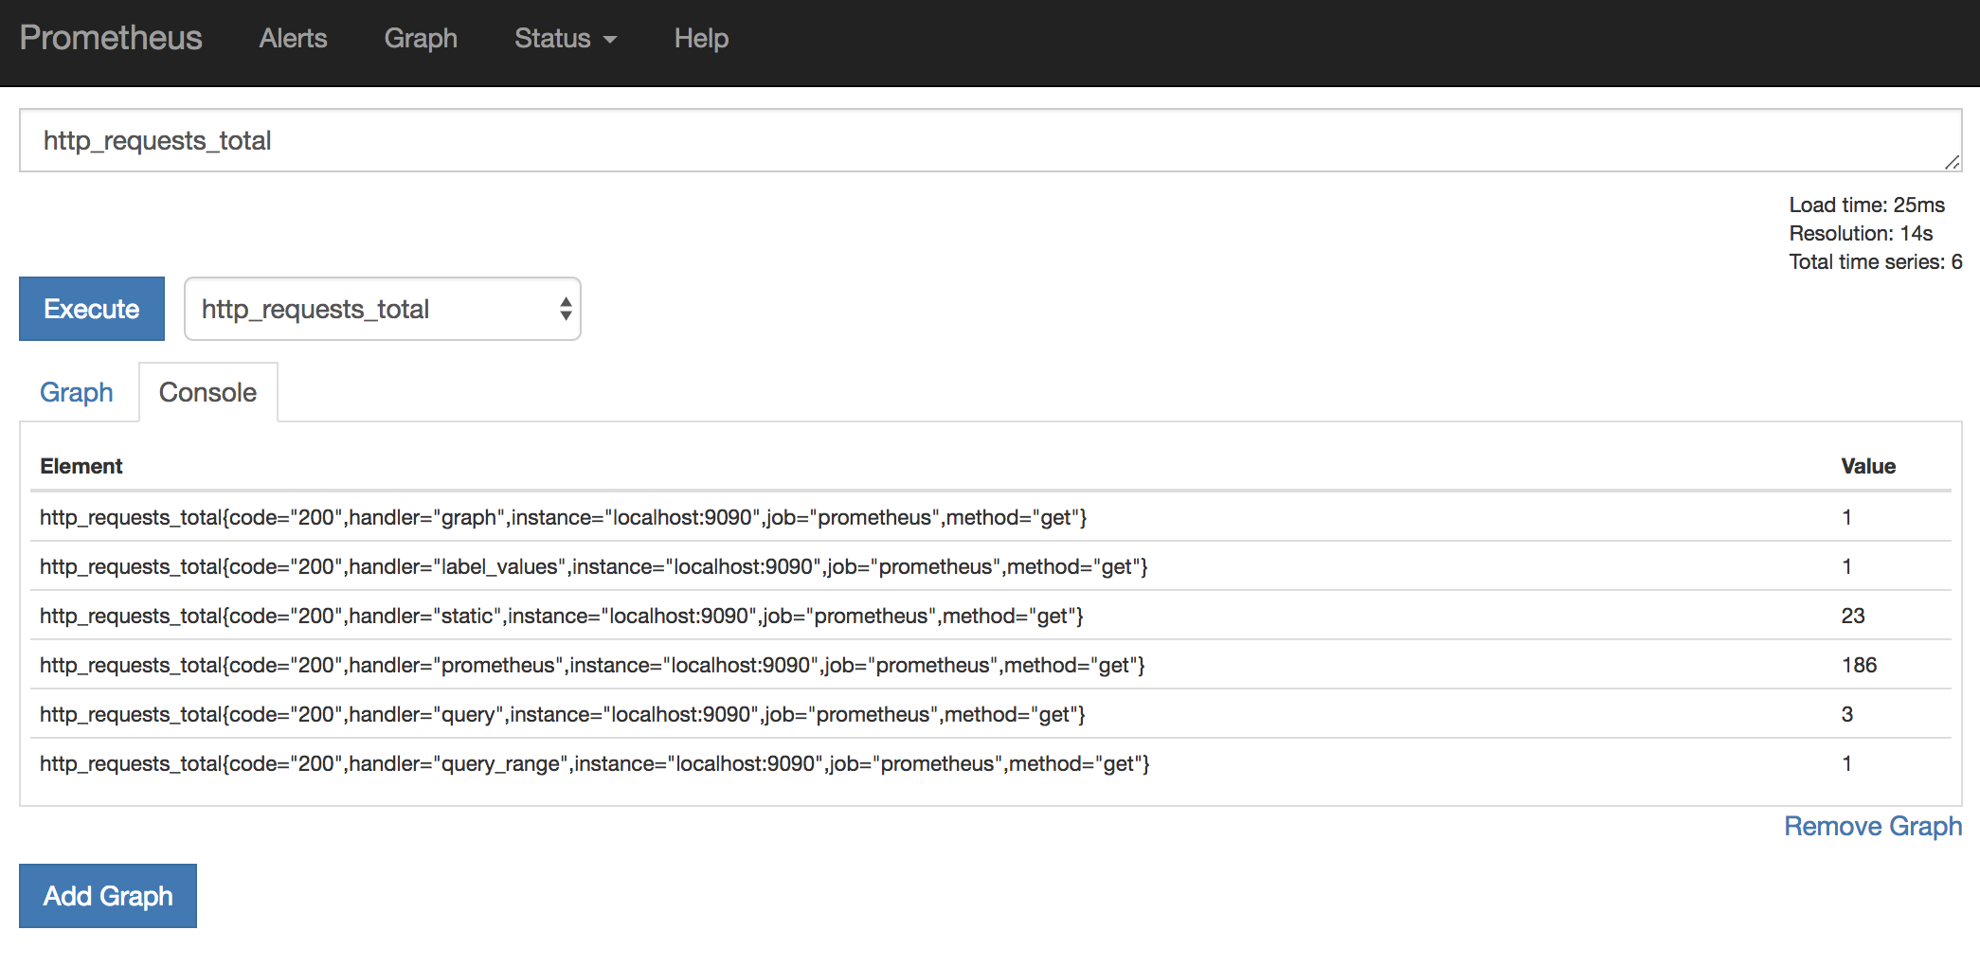
Prometheus
Choose http_request_total metrics, click on Execute
Notes:
Docker metrics for Prometheus
Start Prometheus
6.Choose http_request_total metrics, click on Execute
prometheus-metrics2.png
SOURCE:
https://github.com/docker/labs/blob/master/developer-tools/java/chapters/ch10-monitoring.adoc
Prometheus
Docker metrics for Prometheus
Node health
Query using PromQL (TODO)
cAdvisor
Prometheus and cAdvisor
Monitor Java Applications
Start Java application
Start Prometheus service
View application metrics

Slide 67
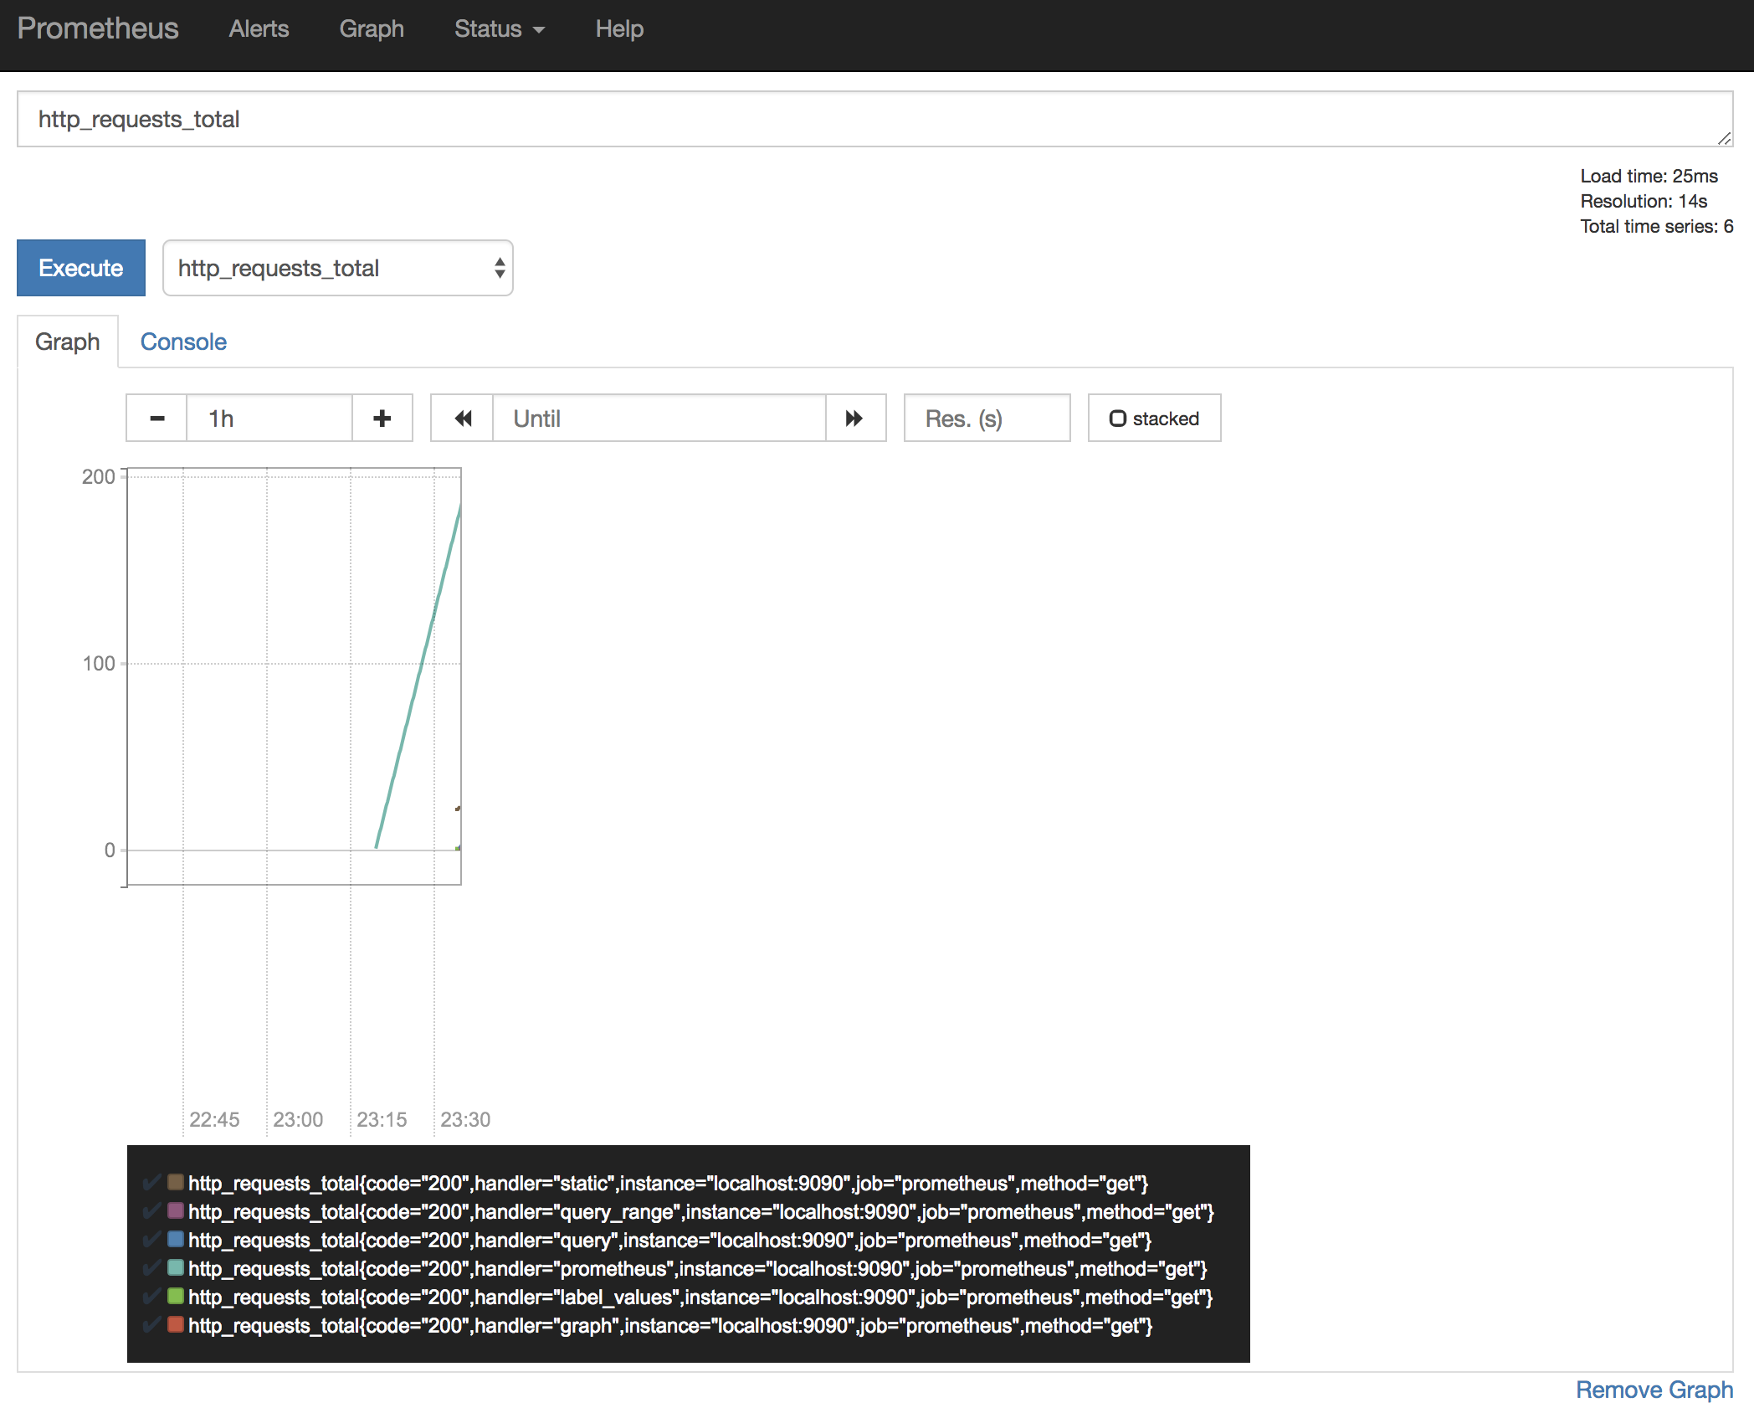
Prometheus
Switch from Console to Graph
Notes:
Docker metrics for Prometheus
Start Prometheus
7.Switch from Console to Graph
prometheus-metrics3.png
8.Change the duration from 1h to 5m
prometheus-metrics4.png
9.Click on Add Graph, select a different metric, say http_requests_duration_microseconds, and click on Execute
prometheus-metrics5.png
10.Switch from Console to Graph and change the duration from 1h to 5m
prometheus-metrics6.png
11.Stop the container: docker container rm -f metrics
Multiple graphs can be added this way.
SOURCE:
https://github.com/docker/labs/blob/master/developer-tools/java/chapters/ch10-monitoring.adoc
Prometheus
Docker metrics for Prometheus
Node health
Query using PromQL (TODO)
cAdvisor
Prometheus and cAdvisor
Monitor Java Applications
Start Java application
Start Prometheus service
View application metrics

Slide 68
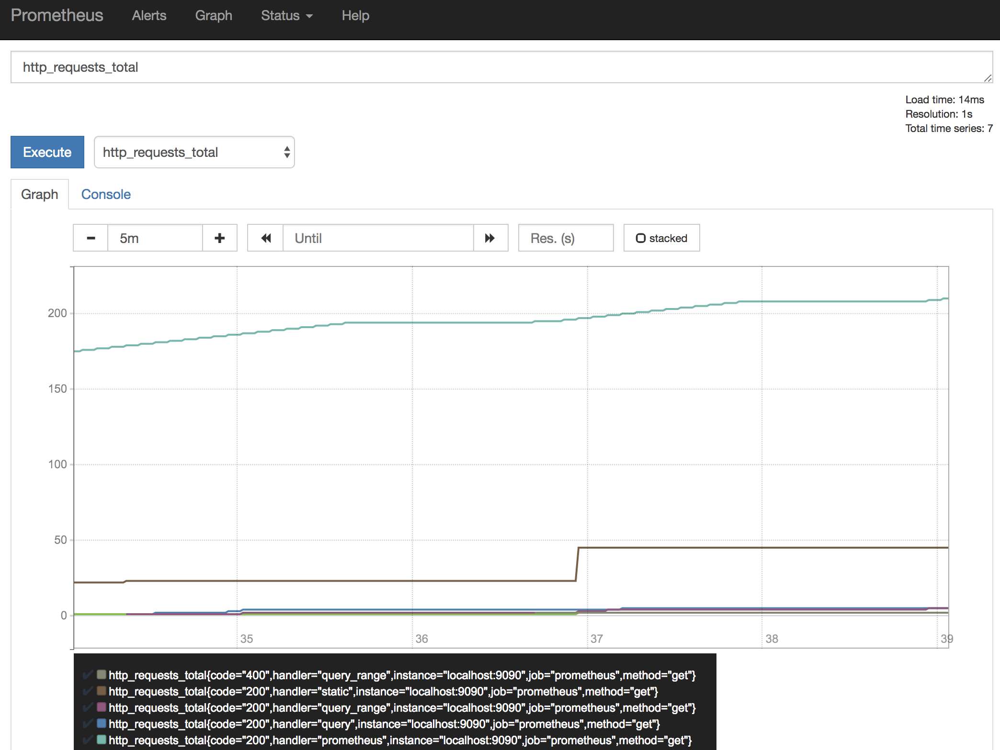
Prometheus
Change the duration from 1h to 5m
Notes:
Docker metrics for Prometheus
Start Prometheus
8.Change the duration from 1h to 5m
prometheus-metrics4.png
9.Click on Add Graph, select a different metric, say http_requests_duration_microseconds, and click on Execute
prometheus-metrics5.png
10.Switch from Console to Graph and change the duration from 1h to 5m
prometheus-metrics6.png
11.Stop the container: docker container rm -f metrics
Multiple graphs can be added this way.
SOURCE:
https://github.com/docker/labs/blob/master/developer-tools/java/chapters/ch10-monitoring.adoc
Prometheus
Docker metrics for Prometheus
Node health
Query using PromQL (TODO)
cAdvisor
Prometheus and cAdvisor
Monitor Java Applications
Start Java application
Start Prometheus service
View application metrics

Slide 69
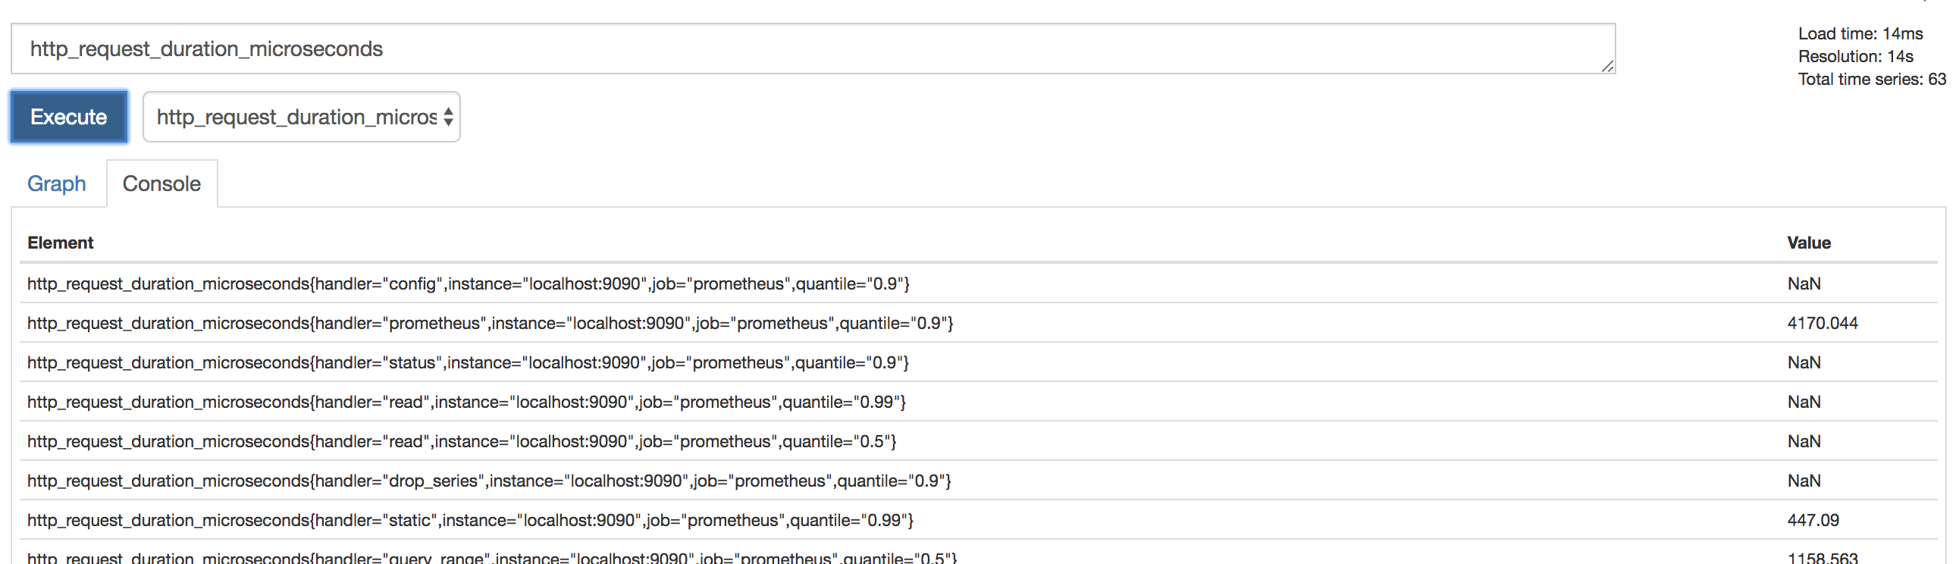
Prometheus
Click on Add Graph, select a different metric, say http_requests_duration_microseconds, and click on Execute
Notes:
Docker metrics for Prometheus
Start Prometheus
9.Click on Add Graph, select a different metric, say http_requests_duration_microseconds, and click on Execute
prometheus-metrics5.png
10.Switch from Console to Graph and change the duration from 1h to 5m
prometheus-metrics6.png
11.Stop the container: docker container rm -f metrics
Multiple graphs can be added this way.
SOURCE:
https://github.com/docker/labs/blob/master/developer-tools/java/chapters/ch10-monitoring.adoc
Prometheus
Docker metrics for Prometheus
Node health
Query using PromQL (TODO)
cAdvisor
Prometheus and cAdvisor
Monitor Java Applications
Start Java application
Start Prometheus service
View application metrics

Slide 70
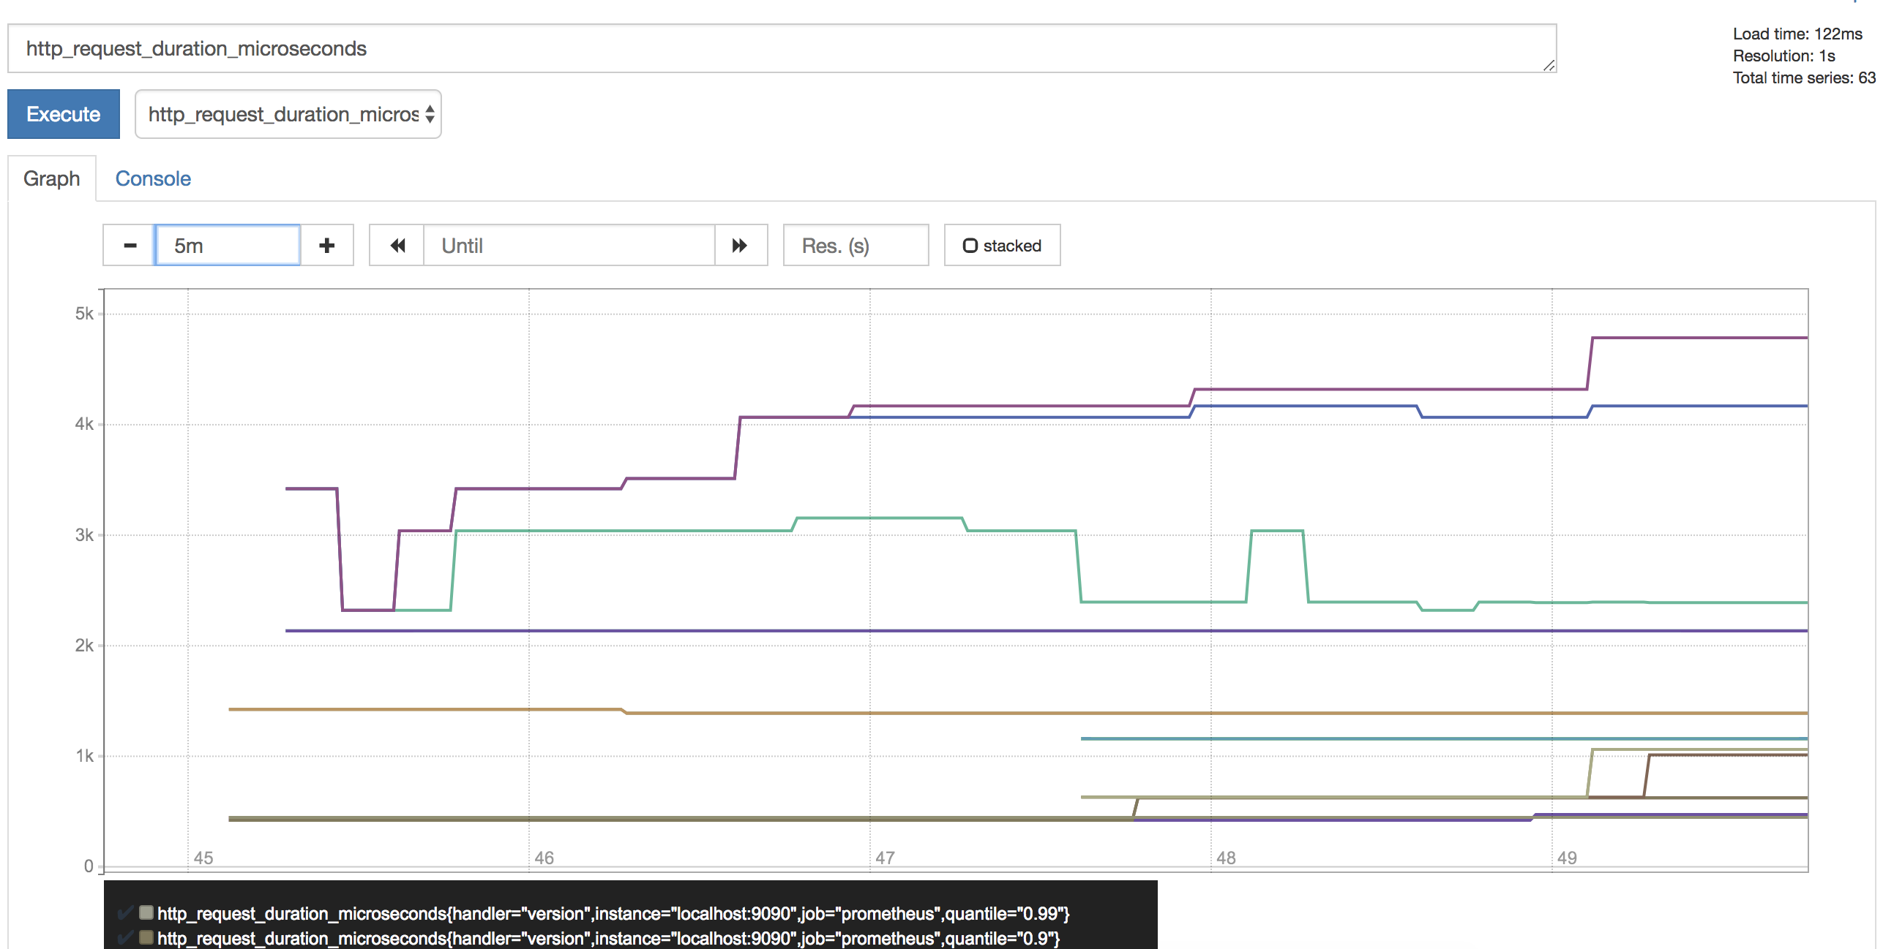
Prometheus
Switch from Console to Graph and change the duration from 1h to 5m
Notes:
Docker metrics for Prometheus
Start Prometheus
10.Switch from Console to Graph and change the duration from 1h to 5m
prometheus-metrics6.png
11.Stop the container: docker container rm -f metrics
Multiple graphs can be added this way.
SOURCE:
https://github.com/docker/labs/blob/master/developer-tools/java/chapters/ch10-monitoring.adoc
Prometheus
Docker metrics for Prometheus
Node health
Query using PromQL (TODO)
cAdvisor
Prometheus and cAdvisor
Monitor Java Applications
Start Java application
Start Prometheus service
View application metrics

Slide 71

Prometheus
Stop the container: docker container rm -f metrics
Multiple graphs can be added this way!
Notes:
Docker metrics for Prometheus
Start Prometheus
11.Stop the container: docker container rm -f metrics
Multiple graphs can be added this way.
SOURCE:
https://github.com/docker/labs/blob/master/developer-tools/java/chapters/ch10-monitoring.adoc
Prometheus
Docker metrics for Prometheus
Node health
Query using PromQL (TODO)
cAdvisor
Prometheus and cAdvisor
Monitor Java Applications
Start Java application
Start Prometheus service
View application metrics

Slide 72
Logging

Slide 73
Logging
Template
$ template
xx.xxx.xx.x
Notes:
SOURCE:
https://docs.docker.com/config/containers/logging/

Slide 74
Visualization/UI for Containers

Slide 75
Visualization/UI for Containers
Template
$ template
xx.xxx.xx.x
Notes:
SOURCE:
https://github.com/docker/labs/blob/master/developer-tools/java/chapters/ch10-monitoring.adoc
Monitor Java Applications
Start Java application
Start Prometheus service
View application metrics
Grafana
Start Grafana
Add Prometheus as data source
Create chart with Prometheus data source

Slide 76
Configuration Management

Slide 77
Configuration Management
Template
$ template
xx.xxx.xx.x

Slide 78
Docker Development Best Pratices

Slide 79
Docker Development Best Practices
The following development patterns have proven to be helpful for people building applications with Docker
For Example: How to keep your images small!
Small images are faster to pull over the network and faster to load into memory when starting containers or services
There are a few rules of thumb to keep image size small...
Notes:
Docker development best practices
The following development patterns have proven to be helpful for people building applications with Docker.
SHARE:
If you have discovered something we should add, let us know.
For example: How to keep your images small
Small images are faster to pull over the network and faster to load into memory when starting containers or services.
There are a few rules of thumb to keep image size small:
SOURCE:
https://docs.docker.com/develop/dev-best-practices/

Slide 80
Keeping Images Small
Start with an appropriate base image
Use multistage builds
If you need to use a version that doesn’t include multistage builds, reduce the number of image layers by minimizing RUN commands in your Dockerfile
Consider the following two fragments:
The first creates two layers in the image, while the second only creates one.
RUN apt-get -y update
RUN apt-get install -y python
RUN apt-get -y update && apt-get install -y python
Notes:
Docker development best practices - Keeping Images Small
There are a few rules of thumb to keep image size small:
Start with an appropriate base image.
SHARE:
For instance, if you need a JDK, consider basing your image on the official openjdk image, rather than starting with a generic ubuntu image and installing openjdk as part of the Dockerfile.
Use multistage builds.
SHARE:
For instance, you can use the maven image to build your Java application, then reset to the tomcat image and copy the Java artifacts into the correct location to deploy your app, all in the same Dockerfile.
This means that your final image doesn’t include all of the libraries and dependencies pulled in by the build, but only the artifacts and the environment needed to run them.
If you need to use a version of Docker that does not include multistage builds, try to reduce the number of layers in your image by minimizing the number of separate RUN commands in your Dockerfile.
SHARE:
You can do this by consolidating multiple commands into a single RUN line and using your shell’s mechanisms to combine them together.
Consider the following two fragments.
RUN apt-get -y update
RUN apt-get install -y python
RUN apt-get -y update && apt-get install -y python
The first creates two layers in the image, while the second only creates one.
SOURCE:
https://docs.docker.com/develop/dev-best-practices/

Slide 81
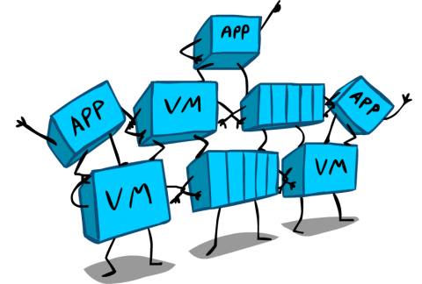
Keeping Images Small
If you have multiple images with a lot in common, consider creating your own base
To keep your production image lean but allow for debugging, consider using the production image as the base image for the debug image
When building images, always tag them with useful tags
Notes:
Docker development best practices - Keeping Images Small
If you have multiple images with a lot in common, consider creating your own base image with the shared components, and basing your unique images on that.
SHARE:
Docker only needs to load the common layers once, and they are cached.
This means that your derivative images use memory on the Docker host more efficiently and load more quickly.
To keep your production image lean but allow for debugging, consider using the production image as the base image for the debug image
SHARE:
Additional testing or debugging tooling can be added on top of the production image.
When building images, always tag them with useful tags which codify version information, intended destination (prod or test, for instance), stability, or other information that is useful when deploying the application in different environments.
SHARE:
Do not rely on the automatically-created latest tag.
SOURCE:
https://docs.docker.com/develop/dev-best-practices/

Slide 82
Where and How to Persist Application Data
Avoid storing application data in your container’s writable layer using storage drivers
Instead, store data using volumes
It is appropriate to use bind mounts is during development
For production, use secrets to store sensitive application data used by services
Use configs for non-sensitive data such as configuration files
If you currently use standalone containers, consider migrating to use single-replica services, so that you can take advantage of these service-only features
Notes:
Where and how to persist application data
Avoid storing application data in your container’s writable layer using storage drivers.
SHARE:
This increases the size of your container and is less efficient from an I/O perspective than using volumes or bind mounts.
Instead, store data using volumes.
One case where it is appropriate to use bind mounts is during development, when you may want to mount your source directory or a binary you just built into your container.
SHARE:
For production, use a volume instead, mounting it into the same location as you mounted a bind mount during development.
For production, use secrets to store sensitive application data used by services, and use configsfor non-sensitive data such as configuration files.
If you currently use standalone containers, consider migrating to use single-replica services, so that you can take advantage of these service-only features.
SOURCE:
https://docs.docker.com/develop/dev-best-practices/

Slide 83
Use Swarm Services When Possible
When possible, design your application with the ability to scale using swarm services
Even if you only need to run a single instance of your application, swarm services provide several advantages over standalone containers
Networks and volumes can be connected and disconnected from swarm services
Several features, such as the ability to store secrets and configs, are only available to services rather than standalone containers
Let docker stack deploy handle any image pulls for you
Notes:
Use swarm services when possible
When possible, design your application with the ability to scale using swarm services.
Even if you only need to run a single instance of your application, swarm services provide several advantages over standalone containers.
SHARE:
A service’s configuration is declarative, and Docker is always working to keep the desired and actual state in sync.
Networks and volumes can be connected and disconnected from swarm services,
SHARE:
and Docker handles redeploying the individual service containers in a non-disruptive way.
Standalone containers need to be manually stopped, removed, and recreated to accommodate configuration changes.
Several features, such as the ability to store secrets and configs, are only available to services rather than standalone containers.
SHARE:
These features allow you to keep your images as generic as possible and to avoid storing sensitive data within the Docker images or containers themselves.
Let docker stack deploy handle any image pulls for you,
SHARE:
instead of using docker pull.
This way, your deployment doesn’t try to pull from nodes that are down.
Also, when new nodes are added to the swarm, images are pulled automatically.
SHARE:
There are limitations around sharing data amongst nodes of a swarm service.
If you use Docker for AWS or Docker for Azure, you can use the Cloudstor plugin to share data amongst your swarm service nodes.
You can also write your application data into a separate database which supports simultaneous updates.
SOURCE:
https://docs.docker.com/develop/dev-best-practices/

Slide 84
Use CI/CD for Testing and Deployment
When you check a change into source control or create a pull request, use Docker Cloud or another CI/CD pipeline to automatically build and tag a Docker image and test it.
Docker Cloud can also deploy tested apps straight into production.
Take this even further with Docker EE by requiring your development, testing, and security teams to sign images before they can be deployed into production
This way, you can be sure that before an image is deployed into production, it has been tested and signed off on
Notes:
Use CI/CD for testing and deployment
When you check a change into source control or create a pull request, use Docker Cloud or another CI/CD pipeline to automatically build and tag a Docker image and test it.
Docker Cloud can also deploy tested apps straight into production.
Take this even further with Docker EE by requiring your development, testing, and security teams to sign images before they can be deployed into production.
This way, you can be sure that before an image is deployed into production, it has been tested and signed off by, for instance, development, quality, and security teams
SOURCE:
https://docs.docker.com/develop/dev-best-practices/

Slide 85
Differences in Dev and Prod Environments
Development | Production
Use bind mounts to give your container access to your source code. | Use volumes to store container data.
Use Docker for Mac or Docker for Windows. | Use Docker EE if possible, with userns mapping for greater isolation of Docker processes from host processes
Don’t worry about time drift. | Always run an NTP client on the Docker host and within each container process and sync them all to the same NTP server. If you use swarm services, also ensure that each Docker node syncs its clocks to the same time source as the containers.
Notes:
Differences in development and production environments
Development Production
Use bind mounts to give your container access to your source code.
Use volumes to store container data.
Use Docker for Mac or Docker for Windows.
Use Docker EE if possible, with userns mapping for greater isolation of Docker processes from host processes.
Don’t worry about time drift.
Always run an NTP client on the Docker host and within each container process and sync them all to the same NTP server. If you use swarm services, also ensure that each Docker node syncs its clocks to the same time source as the containers.
SOURCE:
https://docs.docker.com/develop/dev-best-practices/

Slide 86
Use Official Repositories
Docker Hub contains a number of Official Repositories.
These are public, certified repositories from vendors and contributors to Docker.
They contain Docker images from vendors like Canonical, Oracle, and Red Hat that you can use as the basis to build your applications and services.
With Official Repositories you know you’re using an optimized and up-to-date image that was built by experts to power your applications.
Always use official images from Docker Hub, whenever humanly possible!
Notes:
Use Official Repositories
Docker Hub contains a number of Official Repositories.
These are public, certified repositories from vendors and contributors to Docker.
They contain Docker images from vendors like Canonical, Oracle, and Red Hat that you can use as the basis to build your applications and services.
With Official Repositories you know you’re using an optimized and up-to-date image that was built by experts to power your applications.
SHARE:
Note: If you would like to contribute an Official Repository for your organization or product, see the documentation on Official Repositories on Docker Hub for more information.
SOURCE:
https://docs.docker.com/develop/dev-best-practices/

Slide 87
Hands-on Exercise(s)

Slide 88
Hands-on Exercise(s)
Template
$ template
xx.xxx.xx.x

Slide 89
End of Chapter

